Slide 1
WHAPPING 1.2
The Neolithic Revolution and Early Agricultural Societies
Technological and Environmental Transformations
to c. 600 B.C.E.

Slide 2
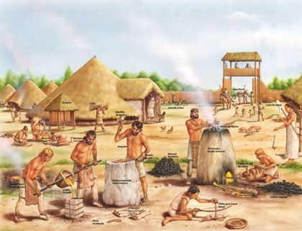
1.2: The Neolithic Revolution and Early Agricultural Societies
End of Ice Age forces humans to adapt to new environs.
Agriculture appears independently in several parts of the world.
Peoples who adopted agriculture changed dramatically: relationship to the environment, permanent settlements, population increase, social class divisions, and patriarchy.
Pastoralists in Africa and Eurasia facilitate technological transfers between regions.

Slide 4
1.2.I: Beginning about 10,000 years ago, the Neolithic Revolution led to the development of more complex economic and social systems.
Be sure to know
the effect of climate change on pre-history humans.
the following geographical regions and their particular patterns of domesticating plants and animals:
Mesopotamia, the Nile River Valley, Sub-Saharan Africa, the Indus River Valley, the Huang He (Yellow River) Valley, Papua New Guinea, Mesoamerica, and the Andes region.
pastoralism and the effects of overgrazing.
how agricultural communities altered the environment.

Slide 5
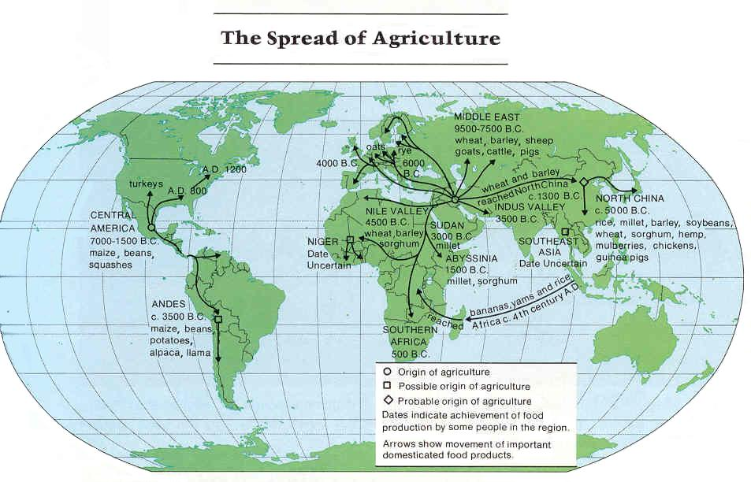

Slide 7
Domesticated Livestock
Major changes triggered by domesticated livestock:
Dietary
Labor
Transportation
Social class
Disease

Slide 8
Beasts of Burden
I'll never be your beast of burden. My back is broad but it's a-hurting. All I want is for you to [work the farm
with me].
I'll never be your beast of burden. I've walked for miles my feet are hurting. All I want is for you to [work the farm
with me].

Slide 9
Um, how about nope?

Slide 10
Pastoralism
Dissemination of ideas and technology
Sub-Saharan Africa, and Central Asia
Nomadic because…

Slide 11
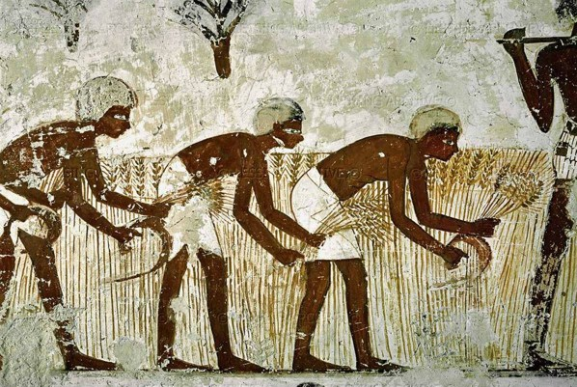
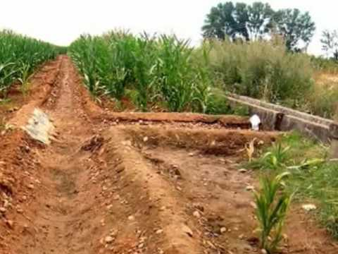
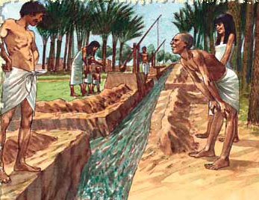
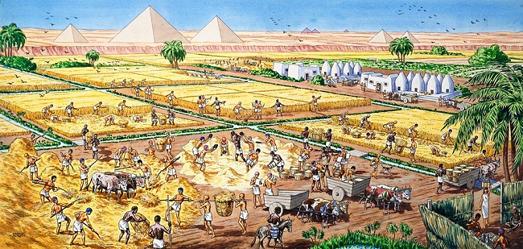
As agriculture became more advanced, new labor systems developed—some cooperative, others coerced.

Slide 12
1.2.II. Agricultural and pastoralism began to transform human societies.
Pastoralism and agriculture lead to reliable food supply and surpluses, leading to:
Population increase and concentration
Specialization of labor
New classes: artisans, warriors, merchants…
The rise of elites.
More technological inventions and innovations to promote more agriculture, trade, and transportation.
Rise of Patriarchal social organization.

Slide 13
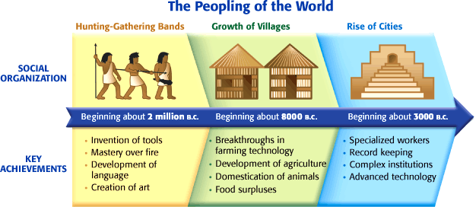

Slide 14
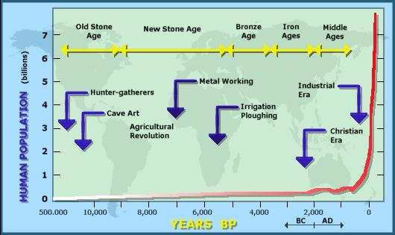
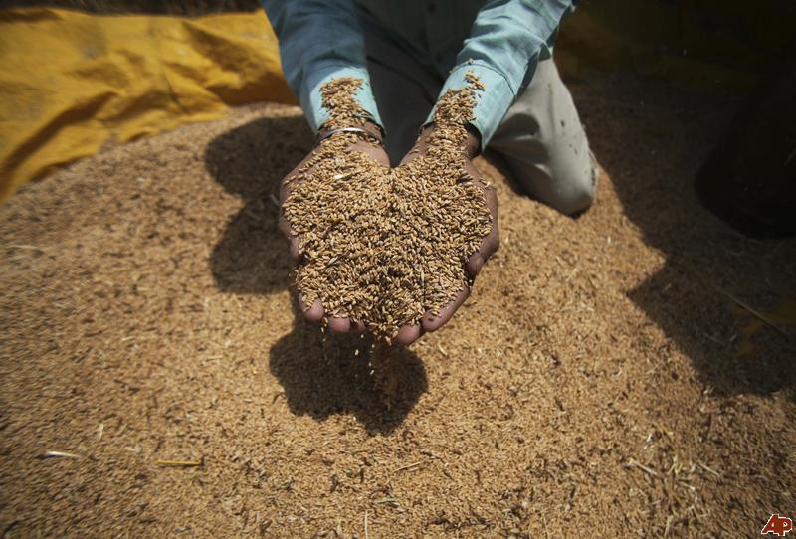
Food Surplus!

Slide 15
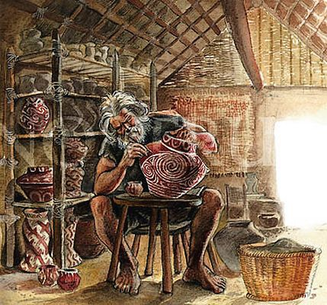
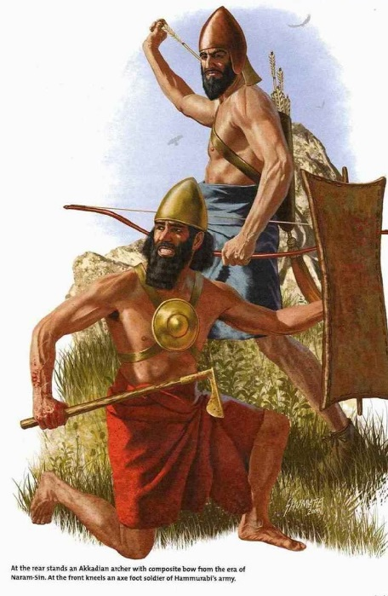
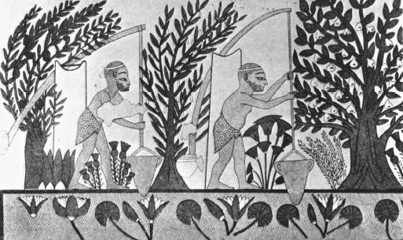
Specialization!

Slide 16
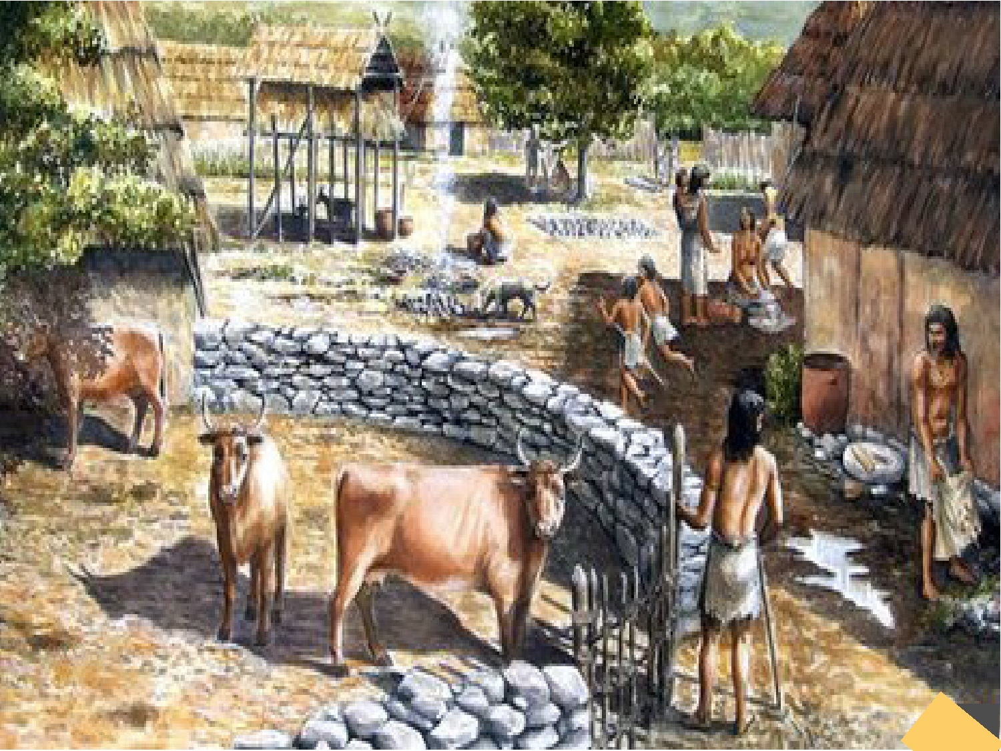
Property Becomes a Thing

Slide 17
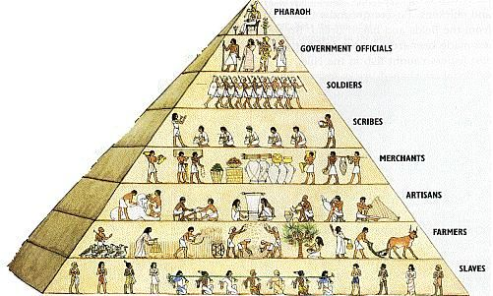
Social Classes and Governments

Slide 18
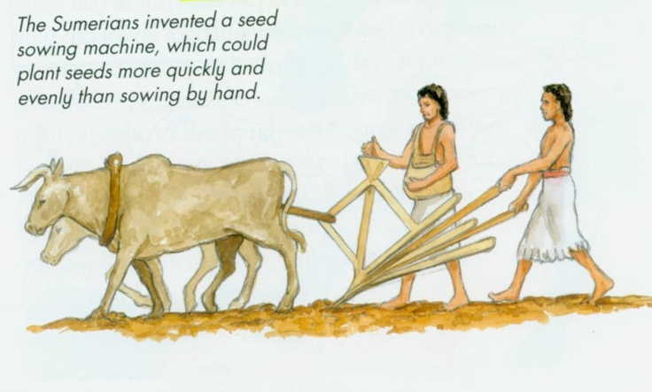
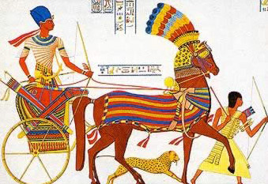
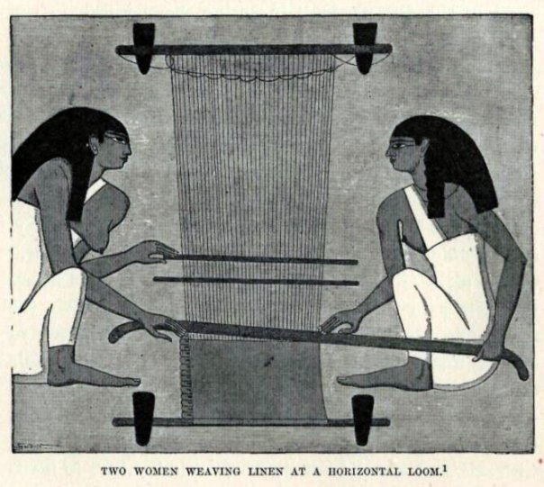
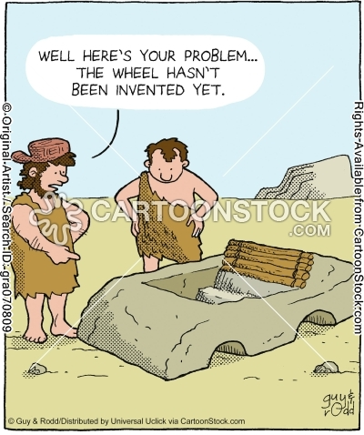
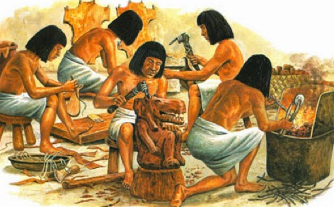
New Technology

Slide 19
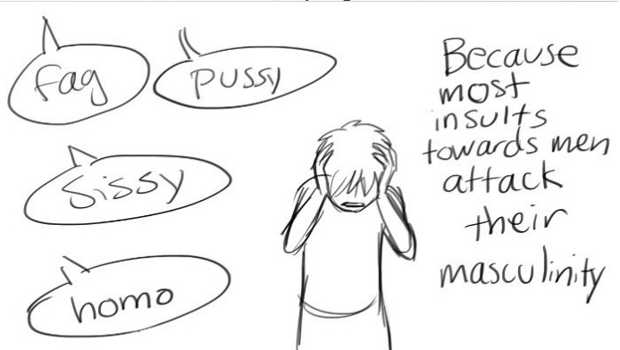
Rise of Patriarchy
Because farming is more like gathering than it is like hunting, perhaps men developed a complex…

