Slide 1
The Transformation of the West, 1450-1750
Renaissance, Reformation, Commerce, Science, & Enlightenment

Slide 2
Big Things
Italy and Commerce
Humanism
Ad fontes
Protestantism
Nation-States

Slide 3
Italian Renaissance v.
Northern Renaissance
Timing
Themes and focus
Why did the Italian Renaissance decline sharply in the 1500s?
Notes:
French and Spanish invasions cut down on political independence; eclipsed by rising nation-states

Slide 4
Rebirth of Civilization
Change or continuity?
Humanism
Architecture and Art
Literature, poetry
Theater

Slide 5
A New Civilization
Vernaculars
Commerce
Urbanization
Science
Politics Families
Religious unity out the window
Notes:
(New businesses emerge, but most still farmers) (Urbanizing, yes, but still very rural) (Observation and experimentation over faith and tradition) (Rise of Nation States) (marriage age, pedagogy)

Slide 6

Demography and Disease
Nuclear families
More urban
Post-Black Death, but cities promote outbreaks of disease
  Exposure promotes resistance and immunity

Slide 7
Migrations and Patterns of Settlement
New commerce leads to urbanization
Landholding wealth and power decreases
To the New World

Slide 8
New Technology
Printing press (Germany) Microscope (Netherlands)
Nautical innovations (Portugal Matches (England)
Mechanical clocks (Italy) Flush Toilet (England)
Eye glasses (Italy) Wallpaper (England)
Telescope (Netherlands) Snootiness (France)
Gunpowder (China, kinda, but…) Better farming and stock-breeding
Each of these have implications!

Slide 9
Religions
Roman Catholicism
Lutheranism
Calvinism
Anglicanism
Deism
et alia

Slide 10
Luther’s Challenge
Luther v. The Church
sola fide, sola scriptura, sola Christe
ad fontes
Priesthood of all believers
Political implication of Lutheranism
Catholic response and Catholic Reformation
Notes:
Catholic reformation--Jesuits

Slide 11
Religious Wars
Persecutions
Edict of Nantes
Thirty-Years War
Treaty of Westphalia (eus regio…)

Slide 12
Deism
Wealthy and educated
Informed by Scientific Revolution
Ambivalent clockmaker
Why did this not appeal to the masses?

Slide 13
Scientific Revolution
What is science and its function?
Some important fellows
Some important ideas
How was it a “revolution”?
How did the new Western science compare with science in other civilizations?
Notes:
Copernicus, Galileo, Newton; John Harvey (circulation of blood in animals); da Vinci, Michelangelo and illegal autopsies
Compare—Westerners linked scientific discoveries to broad philosophical concepts; China more practical; Islamic empires losing innovation

Slide 14
Enlightenment
Inspired by Scientific Revolution
Some important fellows
Some important ideas
What comes of this?

Slide 15
Politics
New structures and forms
Machiavelli’s dilemma
Nationalism and Nation-States
Absolute Monarchy v. Parliaments
Revolts and revolutions
Why the changes?
Notes:
Calvinist support of participation of all believers in church administration was a precursor to wider participation in government.

Slide 16
Society
Secularism; less superstitious
Families
New Classes
New Opportunities
Notes:
Ockham’s Razor (Late Middle Ages); marriage age goes up to late 20s; Nuclear families, different view on children (Locke)

Slide 17
Economics
Banking
Trade
Mercantilism
Capitalism
New classes
How does the Protestant Reformation influence economic changes?
How did silver and gold cause inflation?

Slide 18
CCOTs
Religion
Society
Economics
Politics (government, map)
Art and architecture
Notes:
Much of Northern Europe gains independence from the Church (England, Netherlands, Switzerland, parts of Germany, Sweden)

Slide 19
AbDs
Catholicism v. Lutheranism v. Anglicanism
Renaissance v. Scientific Revolution
Scientific Revolution v. Enlightenment
Middle Ages v. Renaissance
Absolutism v. Parliamentarianism
English Civil War v. Thirty Years War
Italian Renaissance v. Northern Renaissance

Slide 20
Big Qs (In Review)
In what ways did the commercial revolution of the 16th century change the social structure of the West?
How was the absolute monarchy of the 17th century different from the political forms of the Middle Ages?
How did the Scientific Revolution and Enlightenment affect changes in popular outlook in European society?
How is the Protestant Reformation linked to political, social, and economic changes?

Slide 21
Reading Packets
#1 Renaissance
#2 Protestant Reformation
#3 Protestantism and Women
#4 Absolutism and Parliaments
#5 Scientific Revolution and Enlightenment

Slide 22
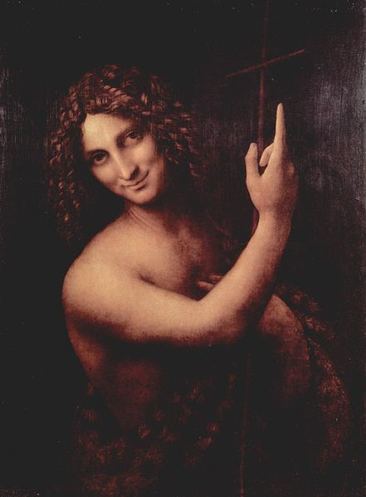
Art and Architecture

Slide 23
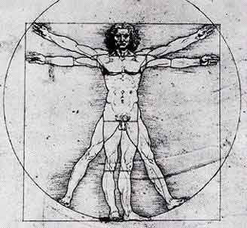

Slide 24
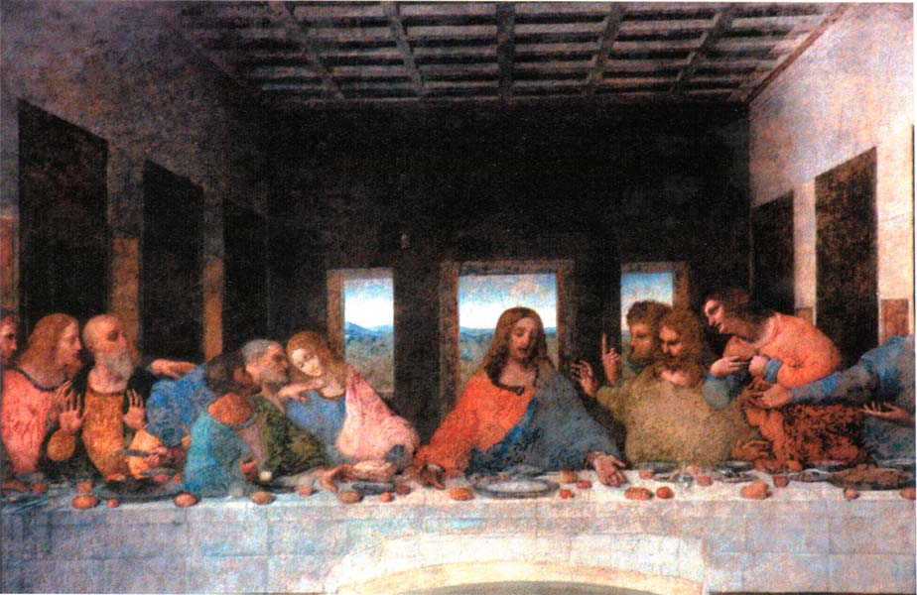

Slide 25
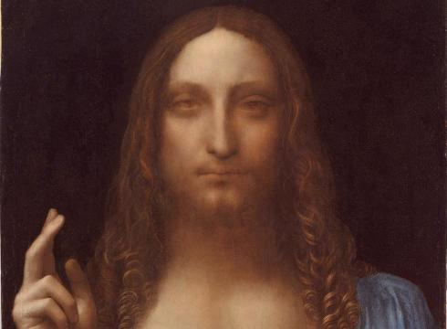

Slide 26
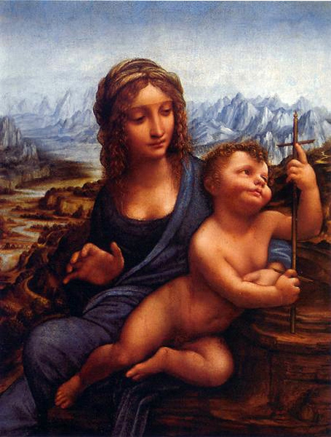

Slide 27
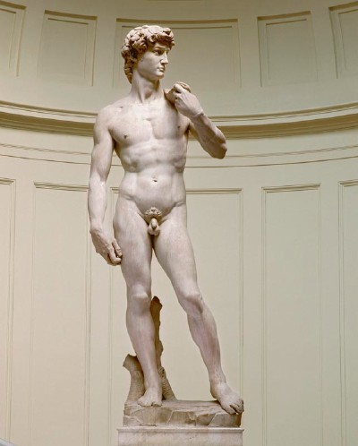

Slide 28
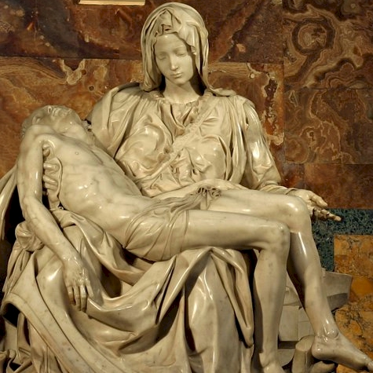
Notes:
Pieta

Slide 29
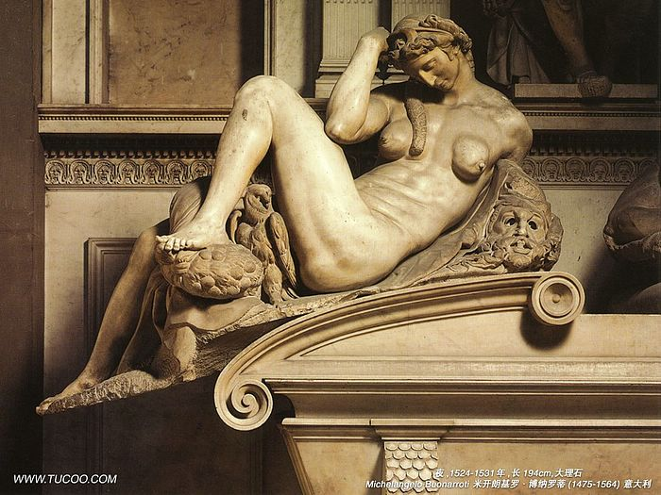

Slide 30
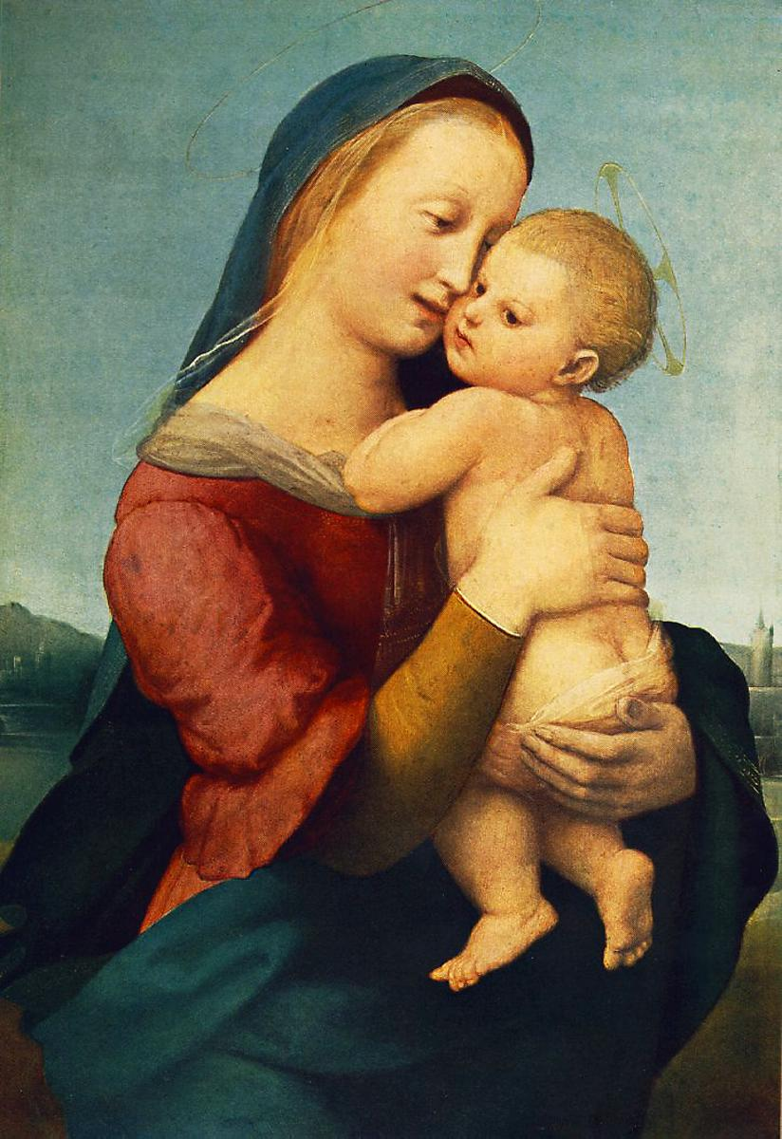
Notes:
Raphael

Slide 31
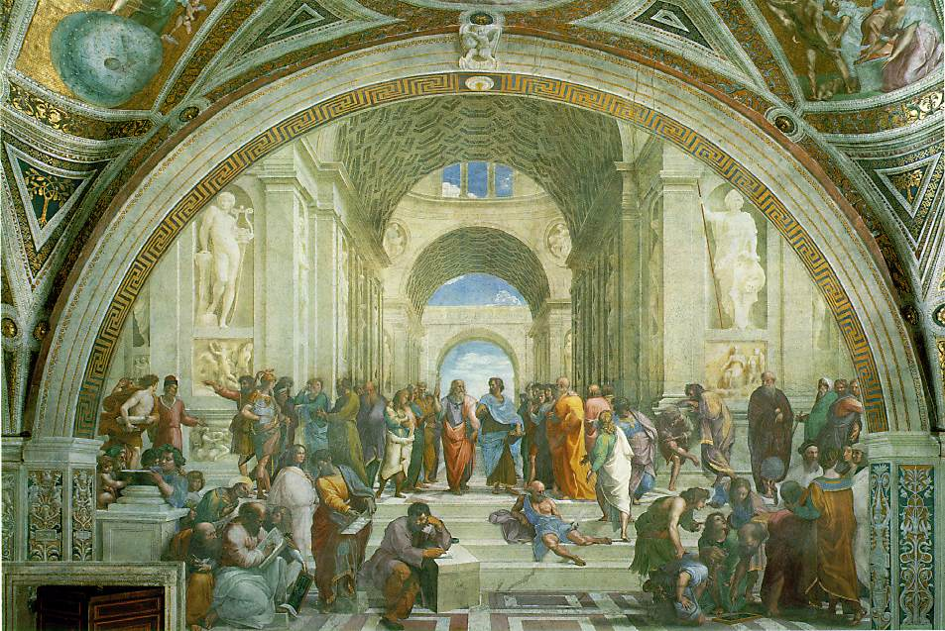
Notes:
Raphael

Slide 32
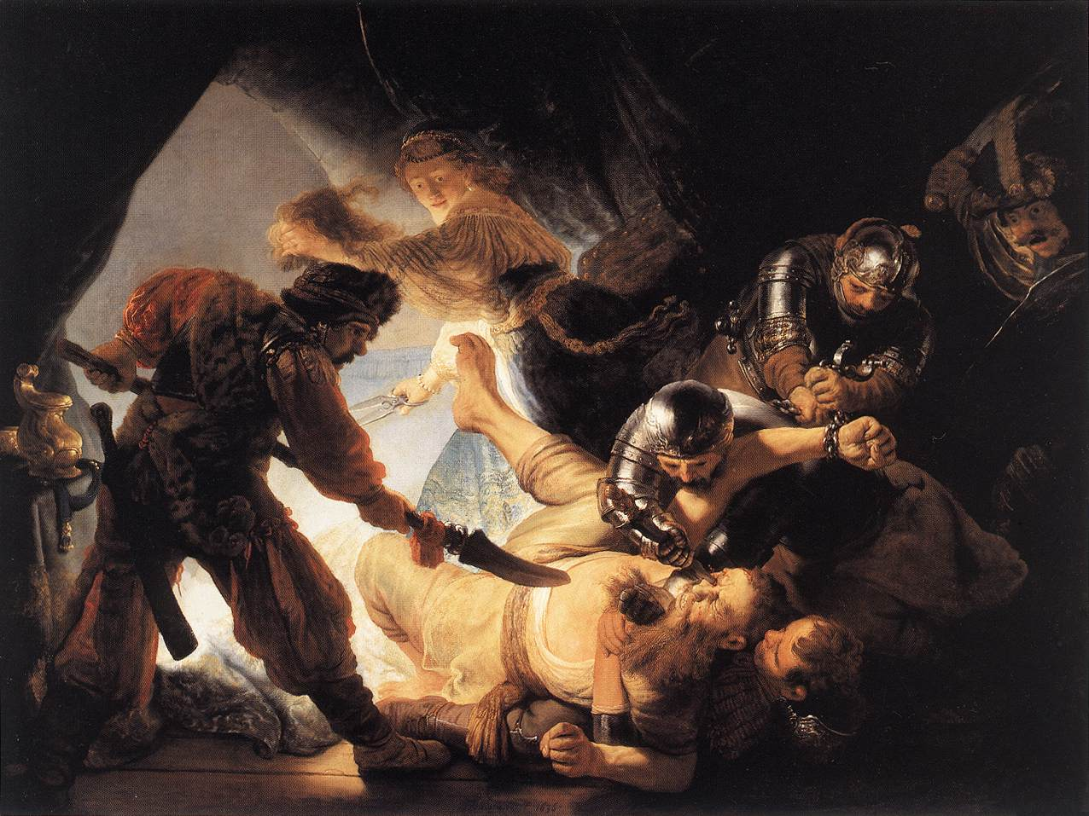
Notes:
Rembrandt

Slide 33
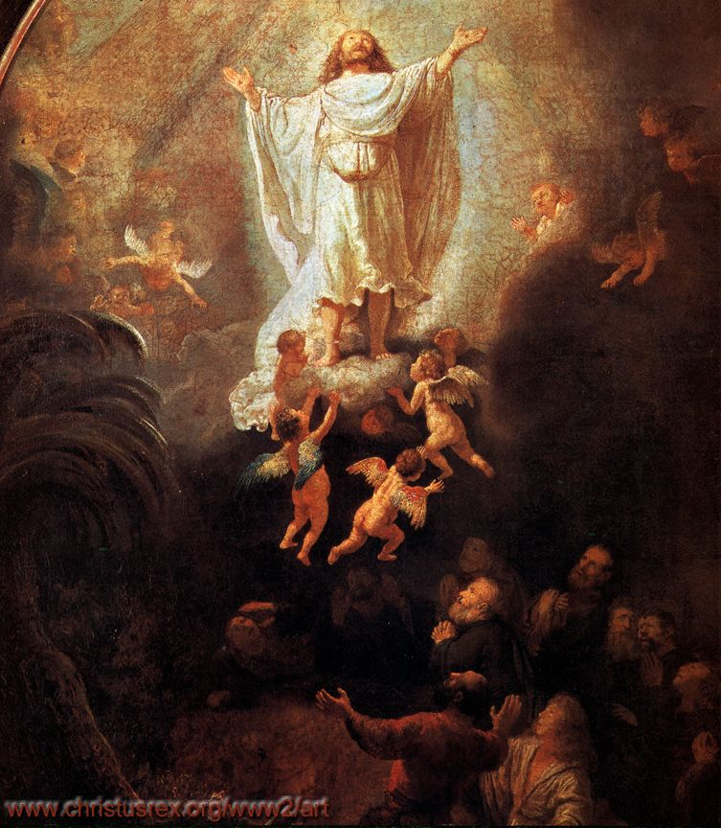
Notes:
Rembrandt

Slide 34
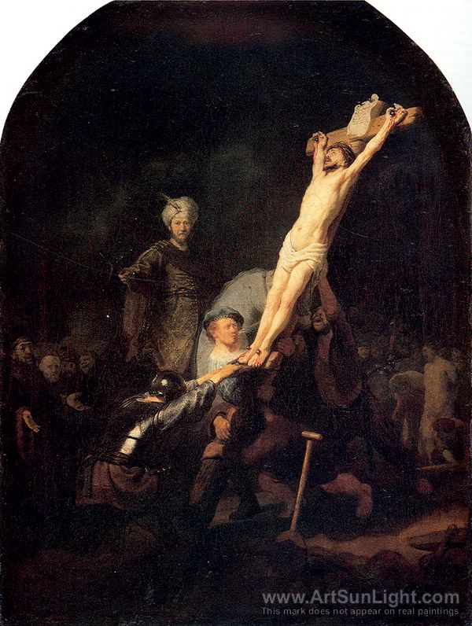

Slide 35
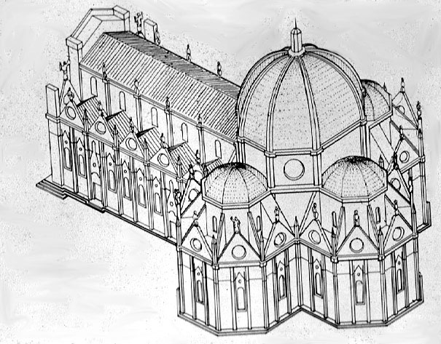

Slide 36
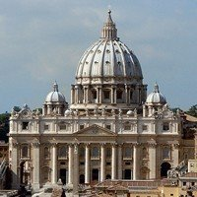

Slide 37
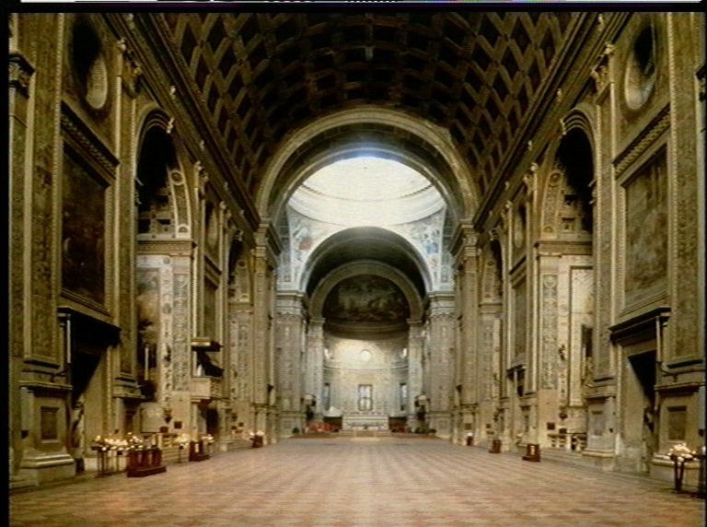

Slide 38
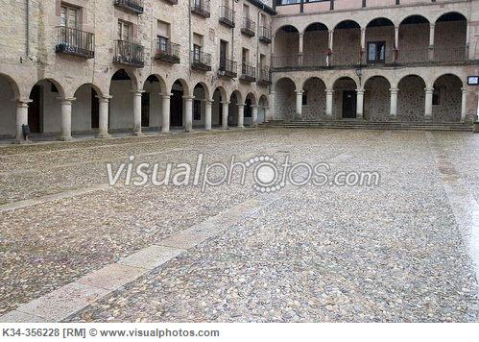

Slide 39
