Slide 1
Period One
1491-1607

Slide 2
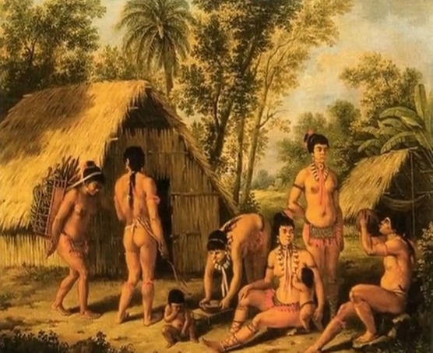
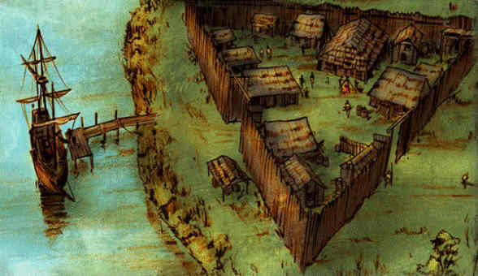
Periodization
“The ability to describe, analyze, and evaluate different ways that historians divide history into discrete and definable periods.”
“Historians construct and debate different. . . models of periodization; the choice of specific turning points or starting and ending dates might accord a higher value to one narrative, region, or group than to another.”
Source: the AP U.S. History Curriculum Framework
Period 1: 1491-1607
1491
1607

Slide 3
Periodization
1492—Turning Point

Slide 4
So Period One Includes
Where and how diverse American Indian populations lived before contact with Europeans and Africans.
What led Europeans to “discover” the Americas.
How contact with Europeans and Africans changed the Americas.
Important Skills at Play
Comparison
Contextualization
Synthesis
Causation
Patterns of Change and Continuity over Time
Analyzing Evidence
Argumentation

Slide 5
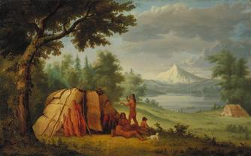
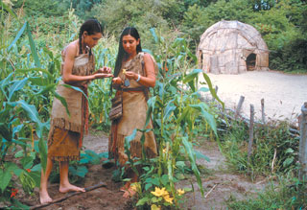
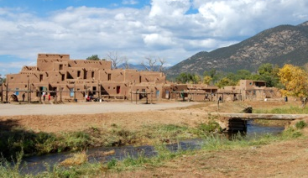
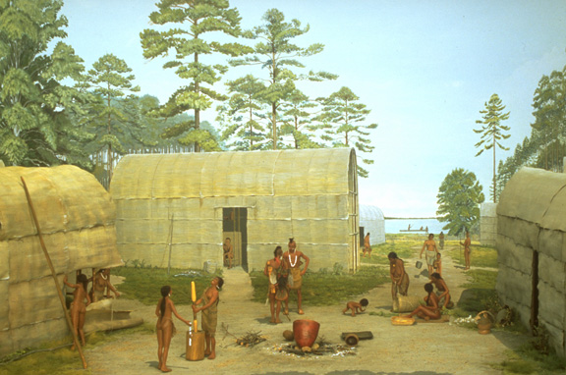
Pre-Columbian Americans (1.1)

Slide 6
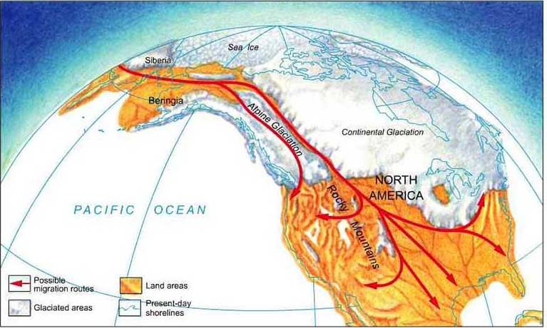
1.1: As native populations migrated and settled across the vast expanse of North America over time, they developed distinct and increasingly complex societies by adapting to and transforming their diverse environments.
As you can see, Canada has not changed much.

Slide 7
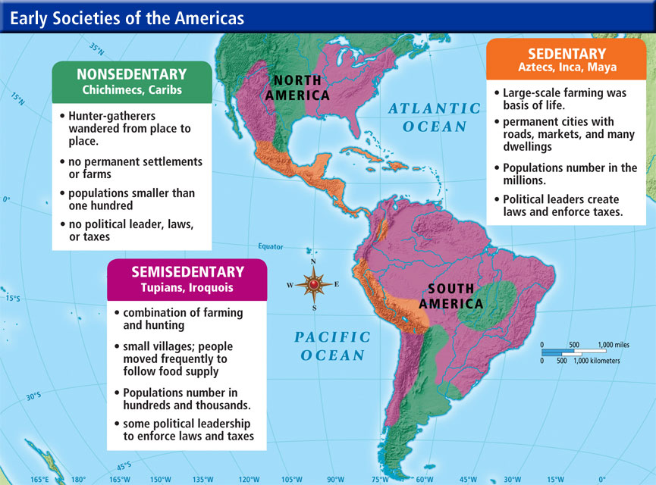
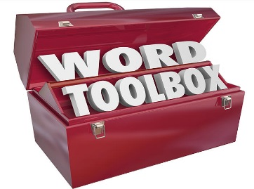
1.1.I: Different native societies adapted to and transformed their environments through innovations in agriculture, resource use, and social structure.

Slide 8
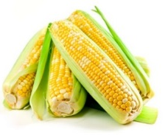
1.1.I.A: Spread of Maize cultivation
1200 B.C.E.
Notes:
The

Slide 9
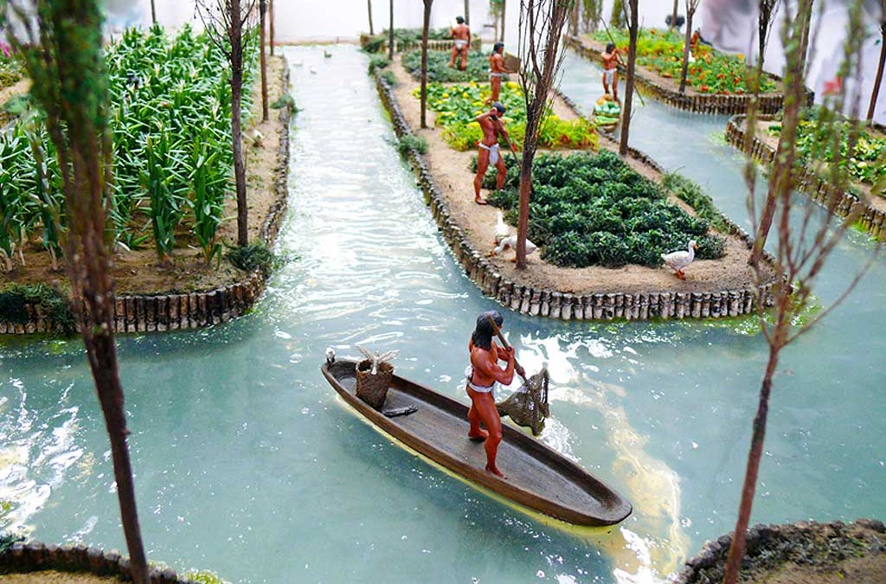
What Maize Means…
Permanent settlements
Environmental change
Food surpluses
Economic development and inequality
Advanced irrigation
Social diversification and stratification
Aztec Chinampa

Slide 10
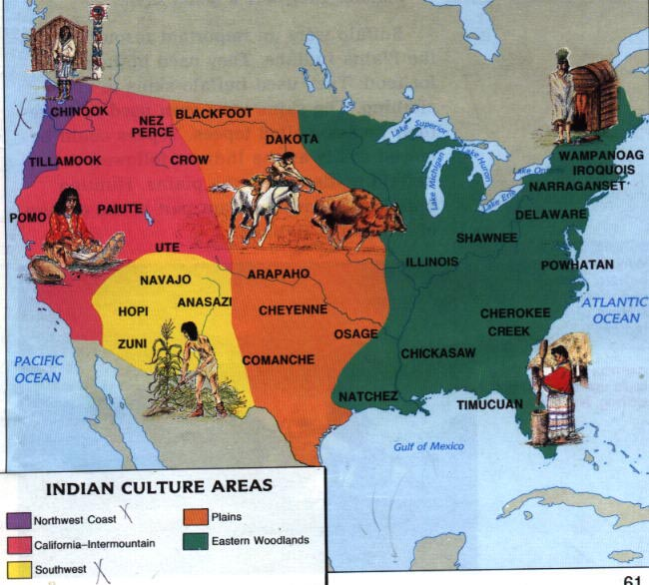
Diverse Cultures (1.1)

Slide 11
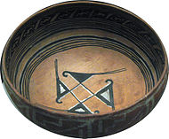
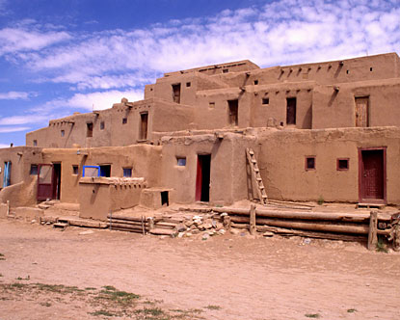
Diverse Lifestyles: Geography Matters (1.1)
Example 1: The Pueblo Nation
American Southwest
Agriculture: corn, beans, squash
Irrigation
Pottery
Multi-storied, terraced buildings
Patrilineal and Matrilineal Clans

Slide 12
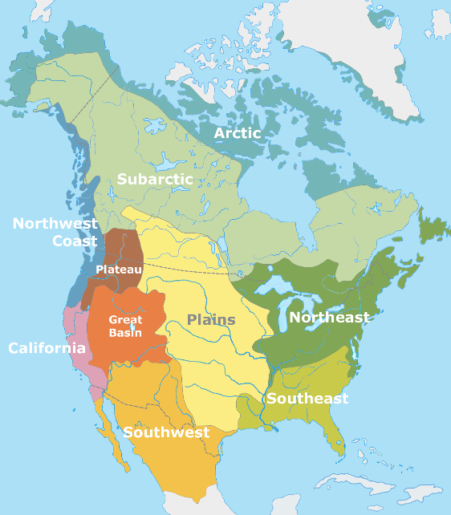
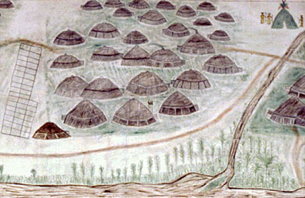
Diverse Lifestyles: Geography Matters (1.1)
Example 2: Shoshone People
Great Basin
Nomadic; hunter-gathering
Bison and smaller game
Seeds, roots, wild rice
Villages and social units
Temporary brush shelters, lean-tos, and wickiups
Gender-based division of labor
Subordination of women
Relative economic egalitarianism
Notes:
Wigwam!
Slash and burn meant a lot was cleared out when the English showed up. Bonus luck!
Where agriculture, women tended to crops while men hunted and fished.

Slide 13
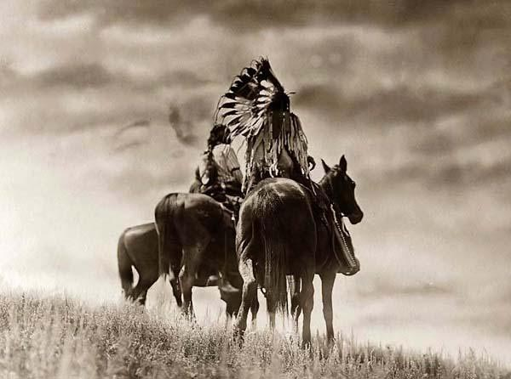
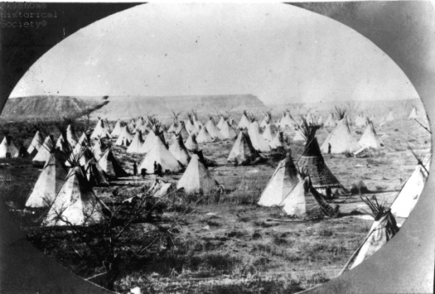
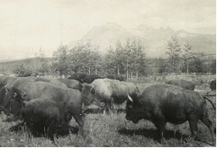
Diverse Lifestyles: Geography Matters (1.1)
Example 3: Cheyenne and Arapaho Nations
Minnesota, Northern Great Plains
Agriculture until horses
Mobile, buffalo hunting
Tepees
Warrior culture, no rigid caste

Slide 14
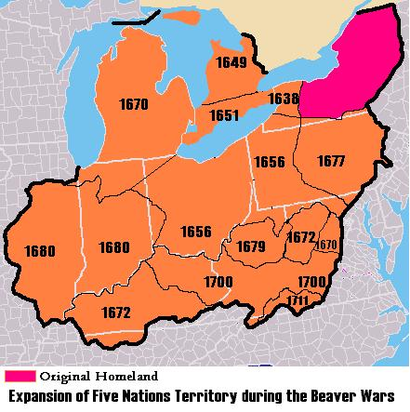
Diverse Lifestyles: Geography Matters (1.1)
Example 4: The Iroquois League
Dekanawida and Hiawatha, founders
Several nations
Wide range of influence
Matrilineal lines, gender equality
Farming, fishing, hunting, & gathering
Melting-pot, Warrior culture
Beaver Wars
(expansion v. Algonquian)
Over fur trapping grounds
Notes:
Dekanawida and Hiawatha, founders
Clan Mother’s appoint leaders. No land ownership: women are stewards of the land. Social status based on mother.

Slide 15
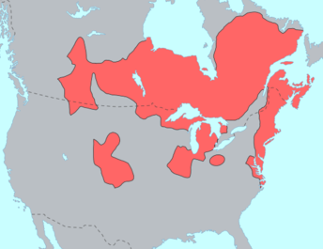
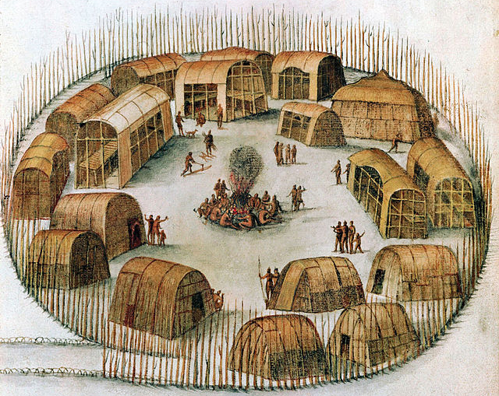
Diverse Lifestyles: Geography Matters (1.1)
Example 5: Algonquian People
Northeast woodlands, Canada
Hunting, fishing, some farming
Slash and burn agriculture
Village social unit
Temporary in northern areas (wigwams)
Gender-based division of labor
Notes:
Wigwam!
Slash and burn meant a lot was cleared out when the English showed up. Bonus luck!
Where agriculture, women tended to crops while men hunted and fished.

Slide 16
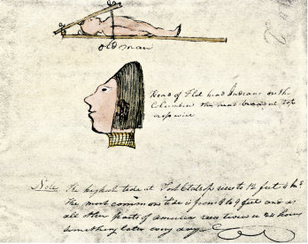
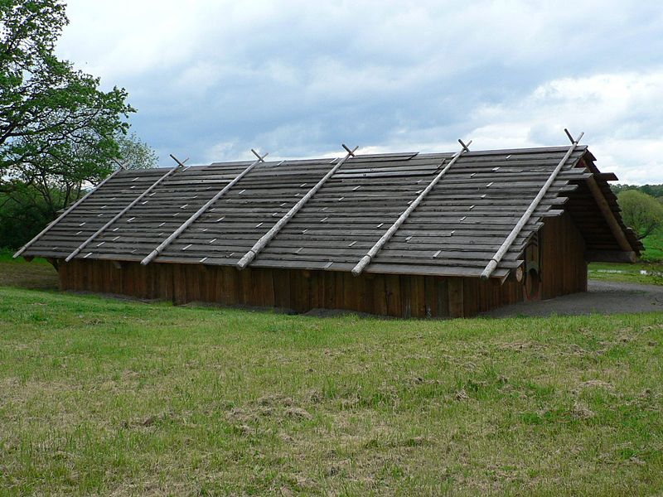
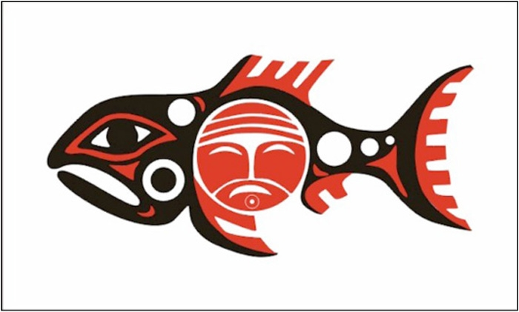
Diverse Lifestyles: Geography Matters (1.1)
Example 6: The Chinook Nation
Pacific Northwest
Salmon and Elk
Longhouses
Caste
Flatheads
Slavery

Slide 17
European Arrival (1.2)

Slide 18
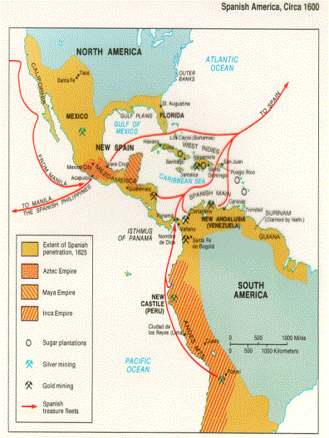
Discovery, Exploration, Conquest (1.2)
Spain Leads the Way
Caribbean
Mexico/Mesoamerica
Florida
American Southwest
South America (not Brazil)
Notes:
Christopher Columbus
Hernan Cortés
Vasco Nuñez de Balboa
Francisco Pizarro
Hernando de Soto
Francisco Coronado

Slide 19
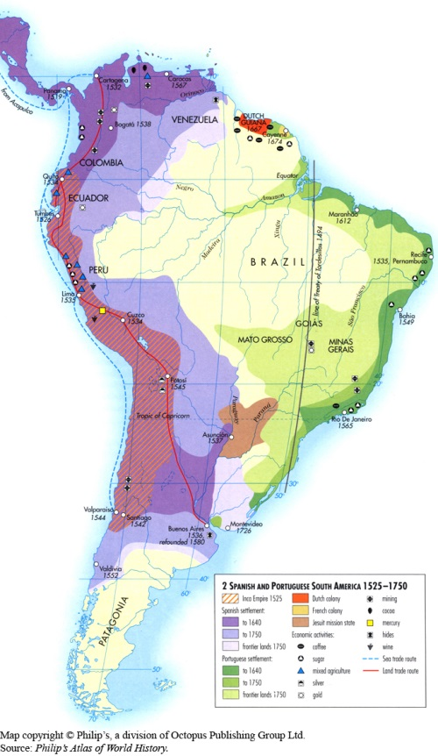
Discovery, Exploration, Conquest (1.2)
Next up, Portugal
Treaty of Tordesillas
Brazil
Why the Iberians first?
Reconquista
Henry the Navigator
Nation-state rivalries

Slide 20
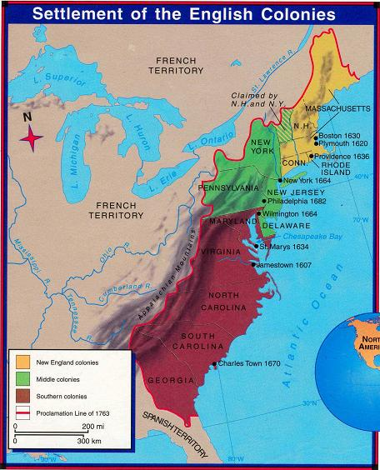
Discovery, Exploration, Conquest (1.2)
England
The 13 Colonies
More later
Canada
Ohio Valley
Some Caribbean Islands

Slide 21
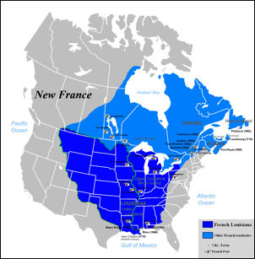
Discovery, Exploration, Conquest (1.2)
France
Canada
Ohio River Valley
Mississippi River Valley
Will lose all in 1763.

Slide 22
Discovery, Exploration, Conquest (1.2)
Others…
New Netherland (lost to England)
New Sweden (lost to England)
Russian Alaska (sold to United States)

Slide 23
The Columbian Exchange (1.2)

Slide 24
New Spain’s Economy
Staple crops
Sugar cane
Tobacco
Precious metals
Silver
Gold
All labor-intensive

Slide 25
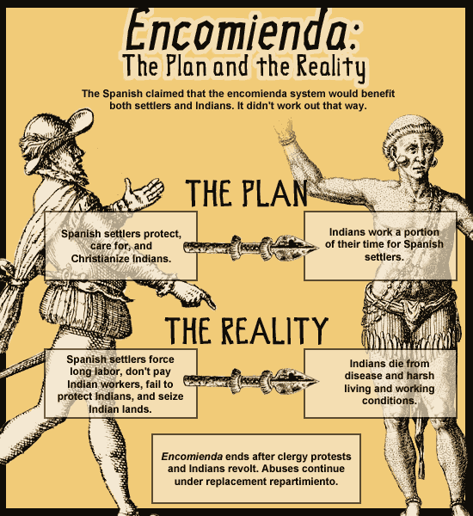

Slide 26
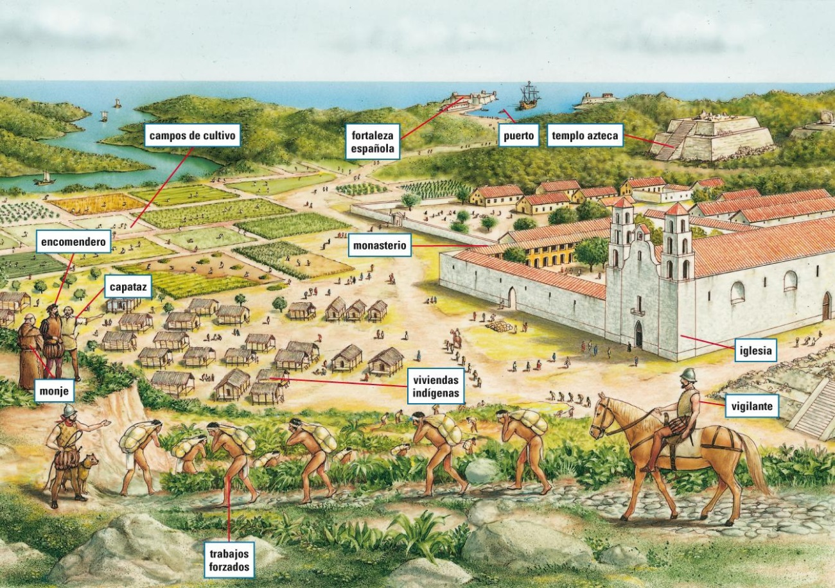

Slide 27
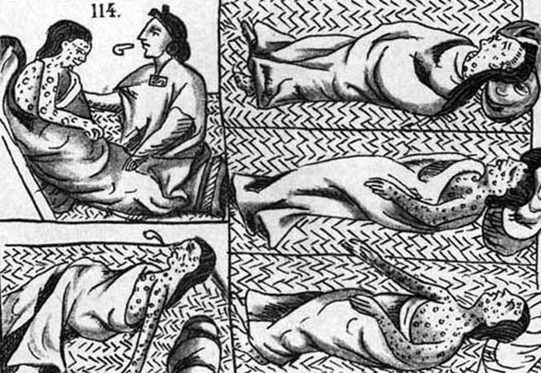
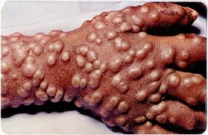
Demographic Consequences of the Columbian Exchange (1.2)
Decline of Native Population
Smallpox
Measles
Influenza
Typhus
Whooping Cough
Diptheria

Slide 28
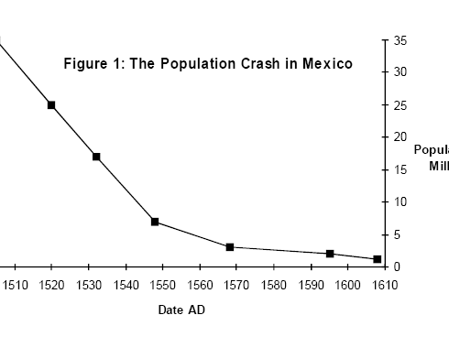

Slide 29
Demographic Consequences (1.2)
Introduction of New Crops (via Columbian Exchange)
Onions
Grapes
Sugar cane
Rice
Wheat
Citrus fruits
Olives
And more…
Which one had the most detrimental impact? Why?

Slide 30
Demographic Consequences (1.2)
Development of African Slave-based economy
Sugar cane=labor intensive
American Indians vulnerable to disease
Partnerships in West Africa
Chattel Slavery

Slide 31
Sugar Plantations (1.2)
Why slaves and not Spaniards?

Slide 32
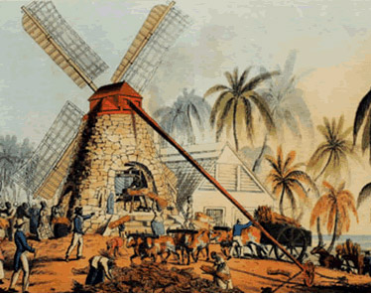
Draft animals powers rollers.
Rollers press cane.
Slaves reach in quickly.
Boil pressed cane to release sugar.
Windmill powers rollers.
Rollers press cane.
Slaves reach in quickly.
Boil pressed cane to release sugar.

Slide 33
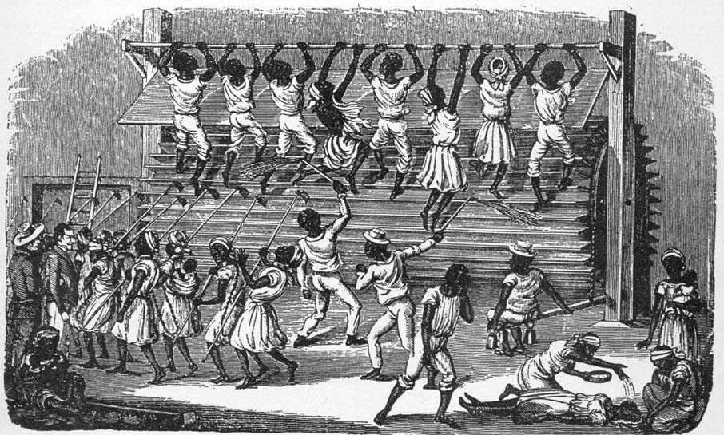
Or maybe just use human power….

Slide 34
So Why Slaves?
Free labor scarcity
Hard, dangerous work
Tradition
Opportunity

Slide 35
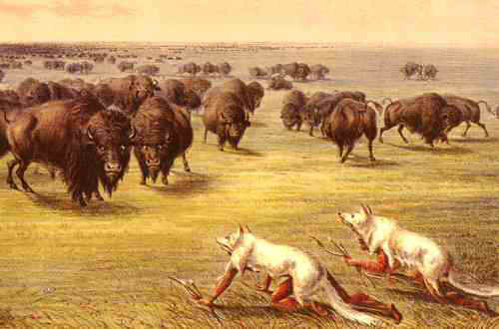
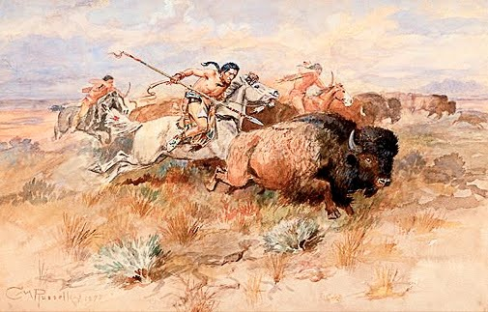
Demographic Consequences (1.2)
Introduction of livestock
Cows mean ranching and grazing
Horses change Plains Indians
Before
After

Slide 36
Demographic Consequences (1.2)
Racial mixing
Few Spanish women move to America, so…
Spanish and American Indian
Spanish and African
Combinations thereof
Less mixing in non-Spanish colonies

Slide 37
Demographic Consequences (1.2)
Race-based Social Hierarchy in New Spain
Peninsulares
Creoles
Mestizos and Zambo (i.e. Mulatto)
Slaves and Full-blood Indians

Slide 38
Conquest (1.2)
Driving forces
Economic
Political
Empire nostalgia
Social/religious

Slide 39
New World Wealth (1.2)
Economic opportunities
Precious metals
Fertile Soil
Raw materials
Lumber
Furs
Ore

Slide 40
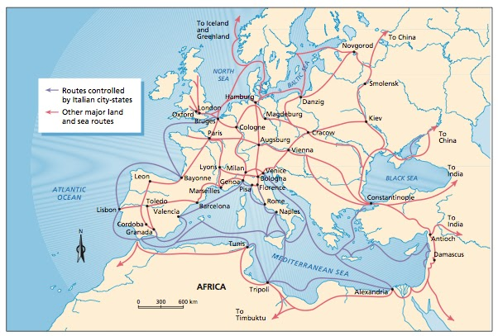
Empire Building (1.2)
Renaissance Commerce
Italy, Asia, Middle-men
Changes wealth paradigm
Vast majority of Asian goods come through here. Look who controls the routes…

Slide 41
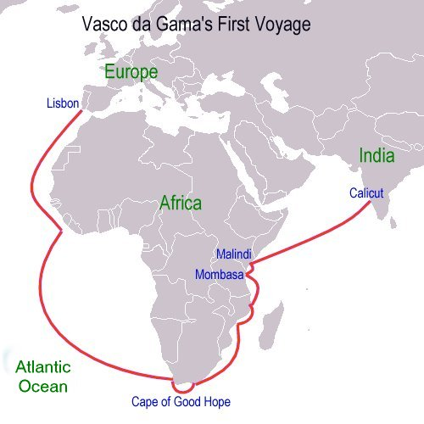
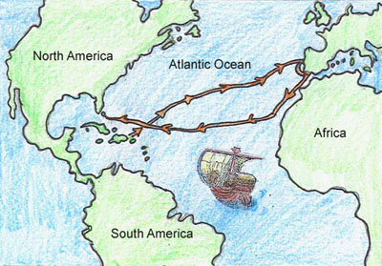
Empire Building (1.2)
So if you’re Portugal…
Or if you’re Spain…
For the record, this isn’t India…

Slide 42
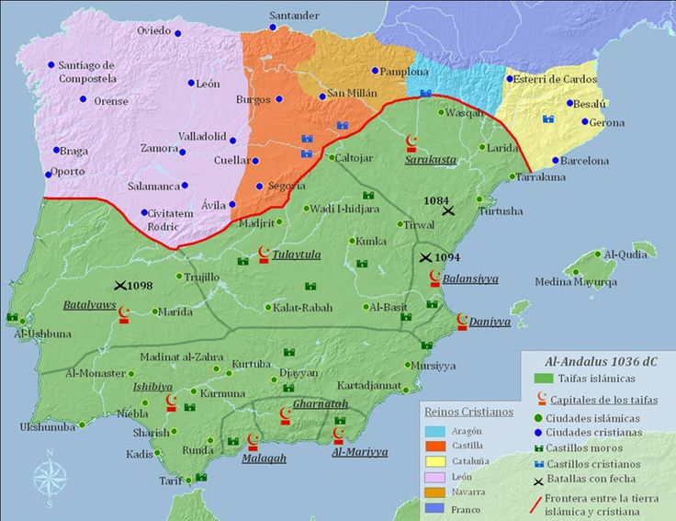
Political Consolidation (1.2)
Reconquista
Decline of Feudalism
Rise of Nation-State
Competition

Slide 43
New World Opportunities (1.2)
Lesser nobles
Hernán Cortés
Second or third sons
Francisco Coronado
Vasco Núñez de Balboa
Walter Raleigh (5th son!)
Gifted commoners
Christopher Columbus
Francisco Pizarro (illegitimate)
John Smith
Samuel de Champlain

Slide 44
Missionary Opportunities (1.2)
Catholic Monastic Orders
Protestant Reformation
Used to Justify Atrocities

Slide 45
European Population Growth (1.2)
New World Crops
Corn
Potatoes
Better diets, lower infant mortality
Encourages migration to New World

Slide 46
New Global Trade (1.2)
Aided by “advanced” technology
Hoisting gear
Printing press
Muzzle-loading rifles
Triggers
Mariner’s Astrolabe
Sextant
New Organizations: Joint-stock Companies
New Economic System: Mercantilism

Slide 47
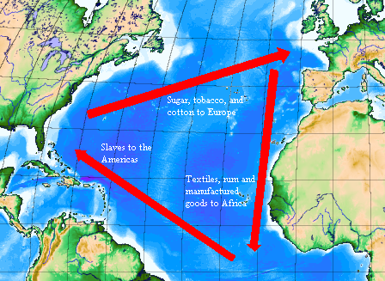
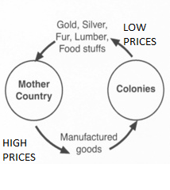
Mercantilism (1.2)

Slide 48
Changing Racial Paradigms (1.3)
Political and Economic Power Imbalance
Religion
Slavery

Slide 49
The American Indian “Problem” (1.3)
Iberia’s tradition of ethnic/cultural conflict
Moors
Reconquista
Christian v. Muslim
Fully human or not?
Juan de Seṕulveda (next slide)
Role of Christianity
Bartolomé de Las Casas

Slide 50
The American Indian “Problem” (1.2)
“Those whose condition is such that their function is the use of their bodies and nothing better can be expected of them, those, I say, are slaves of nature. It is better for them to be ruled thus”
Juan de Seṕulveda, citing Aristotle’s Politics

Slide 51
The American Indian “Problem” (1.2)
“The rulers of Castile are obliged by divine law to see that the faith of Christ is preached in the form which the Son of God left established in His Church. . . . The form consists in attracting . . . the Indians, who are by nature very meek, humble and pacific, in a peaceful, loving, sweet and charitable manner, with gentleness, humility and good examples, . . . rather than by taking anything of theirs away from them. In this way they will consider the God of the Christians to be a good, gentle and just God and will wish to belong to Him and to receive His Catholic faith and holy doctrine. . . . To subject them first by warlike means is a form and procedure contrary to the law, gentle yoke, easy burden and gentleness of Jesus Christ.”
Bartolomé de Las Casas, from “Thirty Very Juridical Propositions”

Slide 52
The Racial Issue (1.2)
Technological Supremacy and Cultural Arrogance
White, Christian Supremacy
Economic and Political Opportunity
Will further develop over time.
Social Darwinism
White Man’s Burden

Slide 53
American Indian Responses (1.2)
Issue: preserve cultural identity and autonomy
Religion
Gender roles
Family structure
Relationship to nature
Methods:
Violent Resistance
Juan de Oñate
Peaceful Resistance
On Missions
In Pueblos

Slide 54
African Responses (1.2)
Violent Resistance Limited
Peaceful Resistance
Maroon communities
Religious syncretism
Vodun

