Slide 1
APUSHING 3.1
British attempts to assert tighter control over its North American colonies and the colonial resolve to pursue self-government led to a colonial independence movement and the Revolutionary War.
In a nutshell: The British try to boss around the colonies, and the colonies say “Oh no you dihn’t!”

Slide 2
3.1.1
I wonder why war broke out in 1754…
The competition among the British, French, and American Indians for economic and political advantage in North America culminated in the Seven Years’ War (the French and Indian War), in which Britain defeated France and allied American Indians.
In a nutshell: (See next slide)

Slide 3
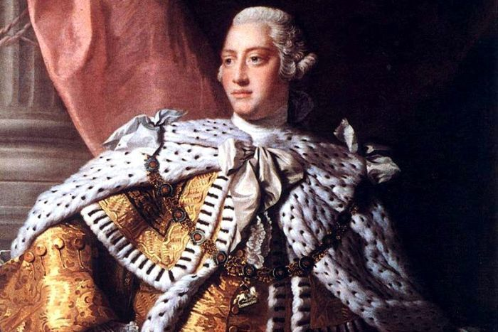
That’s a nice empire you have, there.
Someone conquered it…
It’d be a shame if

Slide 4
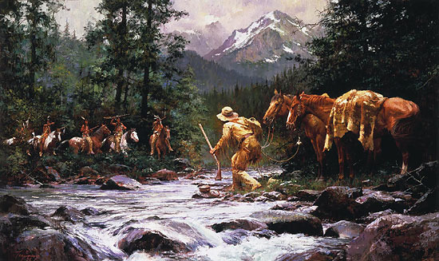
Much Risk for Want of Wealth
Price per beaver parchment and coat (in London)
1713-1722: 5 shillings
1723-1745: 7-9 shillings
1746-1754: 12 shillings
Most Indians preferred trade with the French.

Slide 5
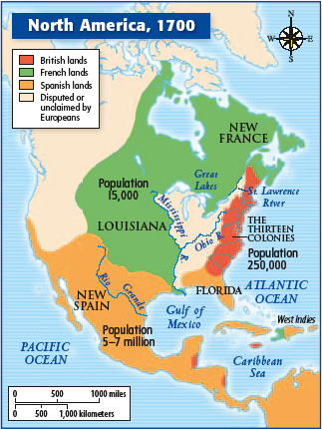
Think Mercantilism…
Beaver pelts
Fertile Ohio Valley
Long-standing rivalry between Britain and France

Slide 6
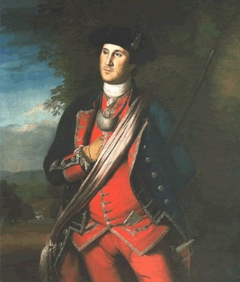
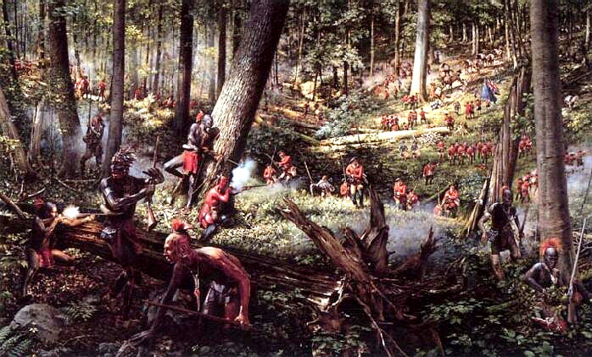
Colonial Involvement
Virginia’s claims
Washington’s mission to Ft. Duquesne
Indian raids on frontier settlements
Disrespected by British regulars
George Washington, 1772

Slide 7
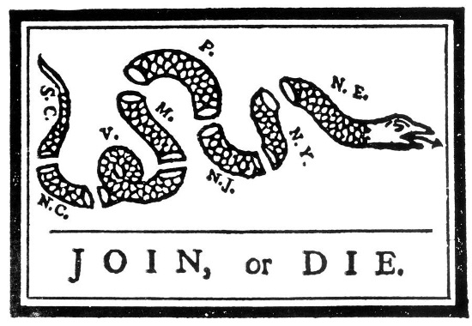
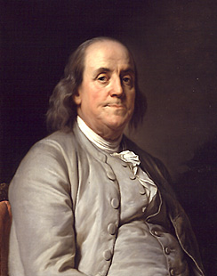
Albany Plan for a Union
“The different manner in which they are settled, the different modes under which they live, the different forms of charters, grants, and frame of government. . . will keep the several provinces and colonies perpetually independent of, and unconnected with each other, and dependent on the mother country.”
--Thomas Pownall, The Administration of the British Colonies (1774)

Slide 8
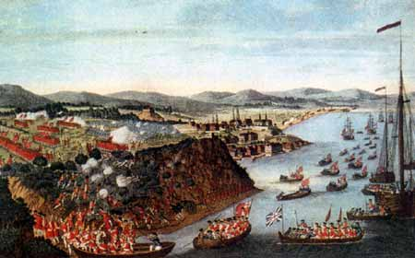
British Involvement
Pitt’s plan
First large deployment of British regulars in North America
Defeat French at Quebec

Slide 9
Outcome of the War

Slide 10
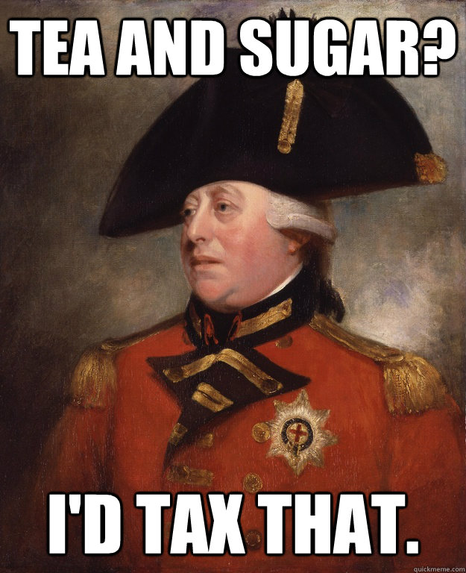
Pyrrhic Victory
Overwhelming debt
People in Britain are “tapped out”
No good solutions for Parliament…

Slide 11
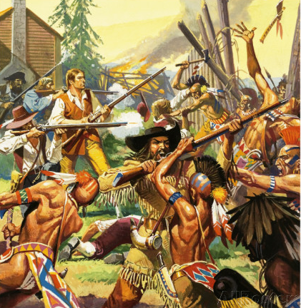
Frontier Problems
Pontiac’s Rebellion
Proclamation Act of 1763
March of the Paxton Brothers
And 92 others, according to Jay Z…

Slide 12
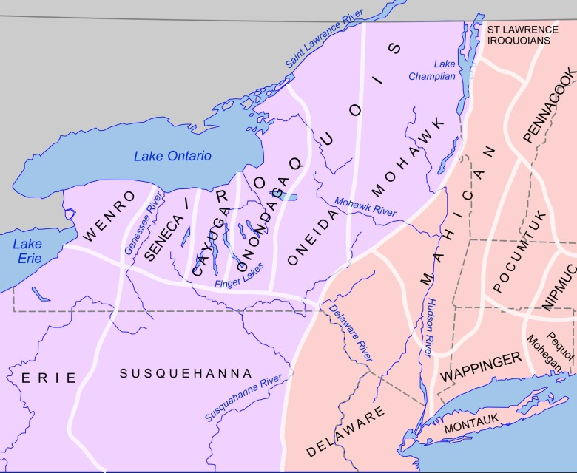
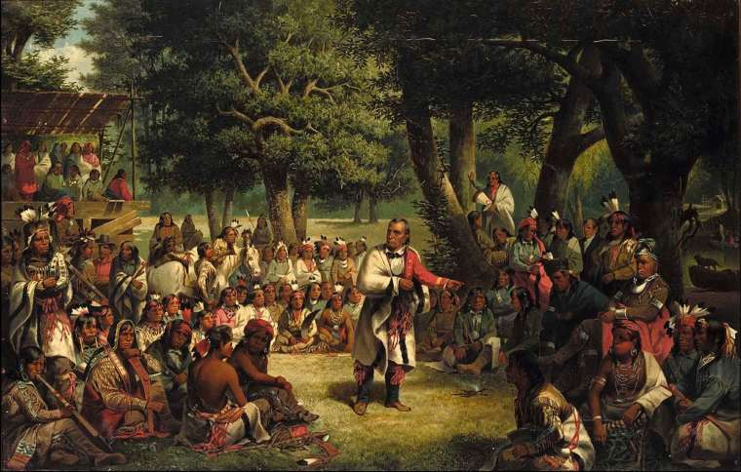
British Indian Allies: The Iroquois

Slide 13
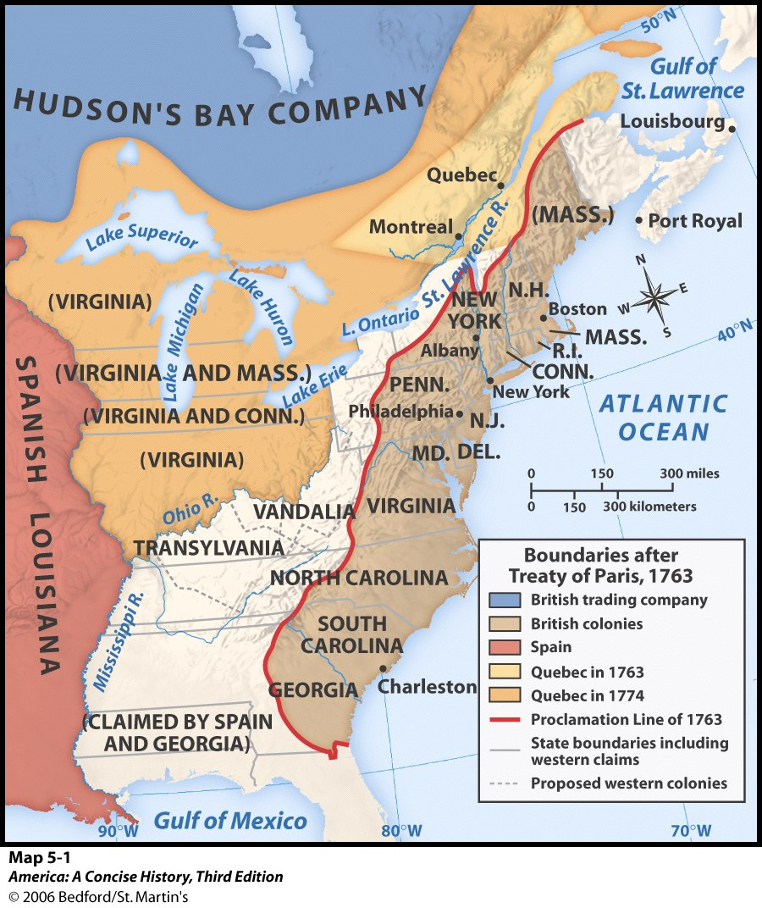
Proclamation Act of 1763
British close lands to settlement
Colonists resent this and claim right to settle
10,000 redcoats enforce the proclamation, need to be quartered and paid.

Slide 14
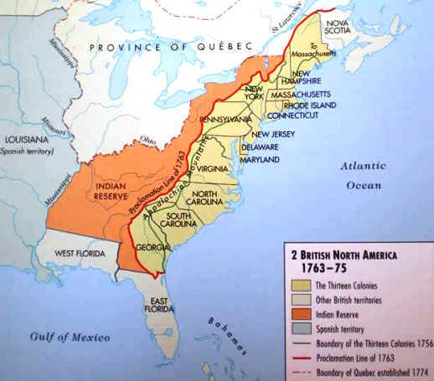
Proclamation of 1763
Why do you think this would upset the colonists?
Connect to the start of the war and Washington’s original mission.

Slide 15
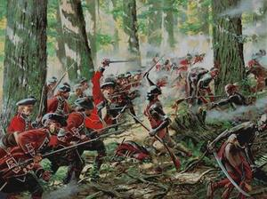
Pontiac’s Rebellion

Slide 16
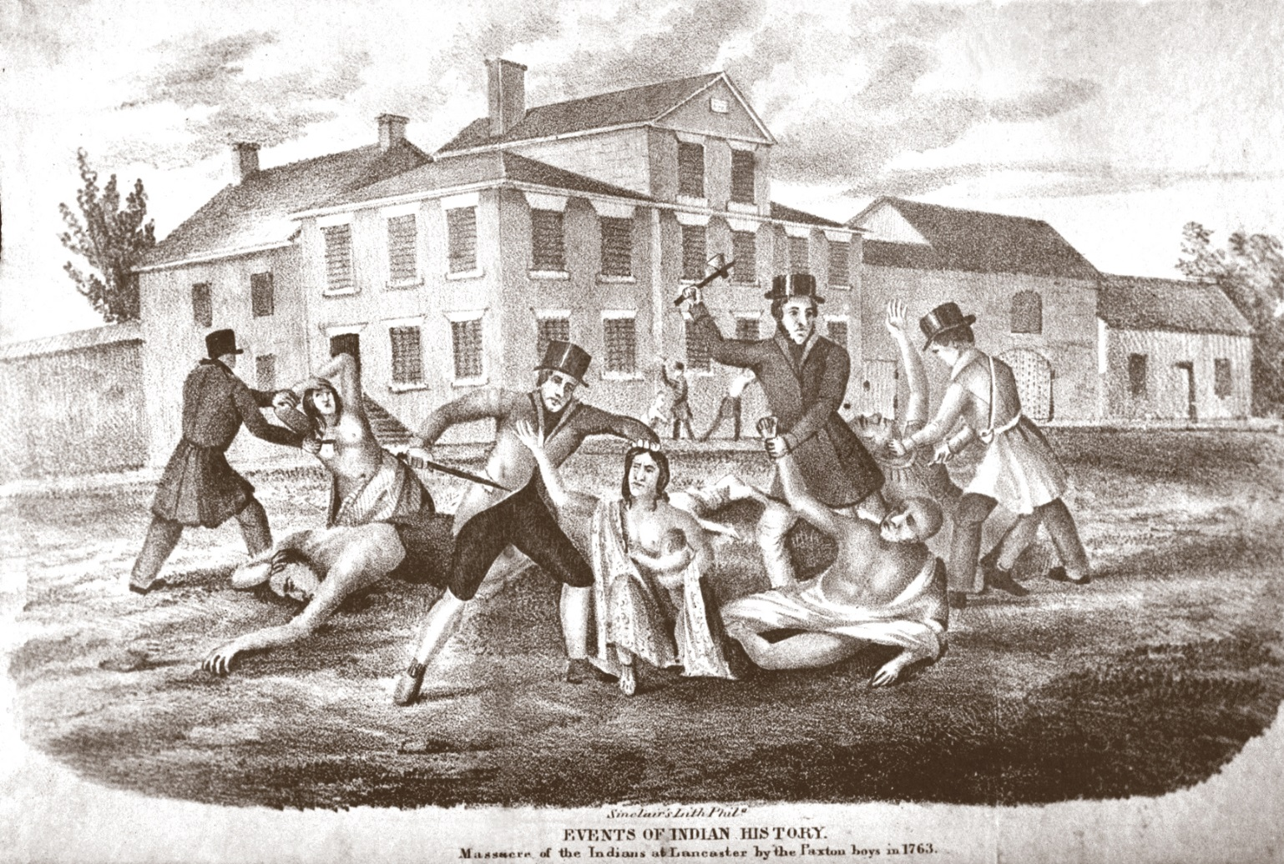
March of the Paxton Boys
Scots-Irish regard Quakers as too “nice”
Conestoga Massacre (1763), last 20 Conestoga Indians die
Governor wants to try the men for murder
250 Scots-Irish march on Philly
Compare to Bacon’s Rebellion

Slide 17
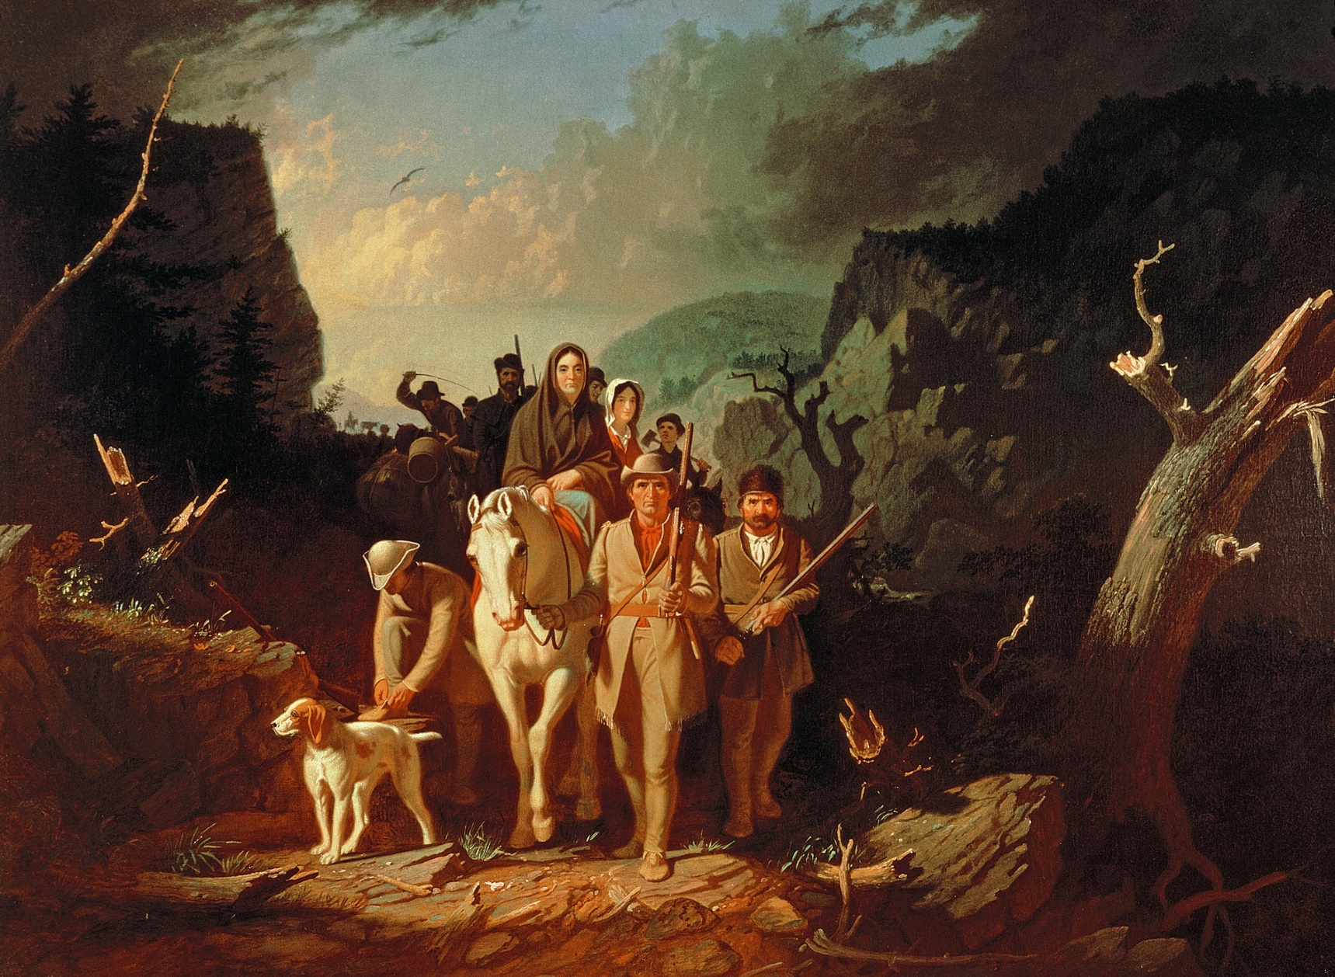
Daniel Boone and Others…
Boone reaches Kentucky in 1767
What does this tell us?

Slide 18
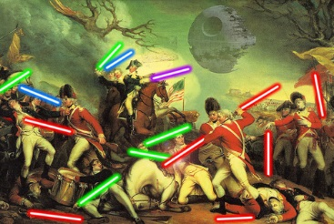
3.1.2
The desire of many colonists to assert ideals of self-government in the face of renewed British imperial efforts led to a colonial independence movement and war with Britain.
In a nutshell: There’ll be one less set of footsteps on your floor in the morning.

Slide 19
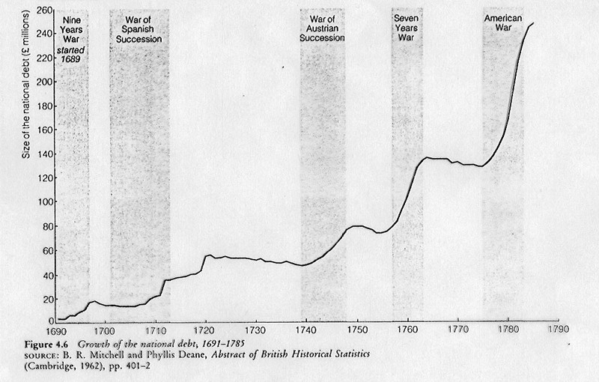
Brother, Can You Spare a Few Billion Dimes?
War Doubles Britain’s National Debt to £122,000,000
£4,400,000 annual interest…

Slide 20
End of Salutary Neglect and Beginning of Alienation
Be able to connect the dots…
Proclamation of 1763
Sugar Act (1764)
Quartering Act (1765)
Stamp Act (1765)
Declaratory Act (1765)
Townshend Acts (1767)
Mrs. Hall Born (1768)
Boston Massacre (1770)
Gaspee Incident (1772)
Boston Tea Party (1773)
Coercive Acts (1774)
Quebec Act (1774)

Slide 21
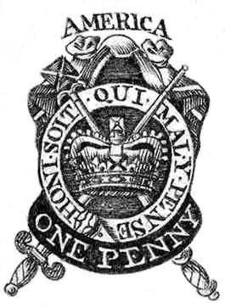
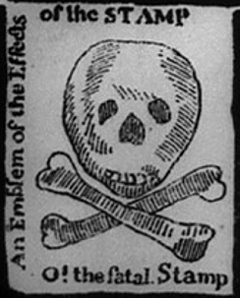
Relatively Small Taxes; Relatively Major Problems
At play…
Magna Carta
English Mindset and the Enlightenment
Colonial Identity Issues
Colonial Resistance
Sons of Liberty
Smuggling, Civil Disobedience
Stamp Act Congress (1765)
British Response
Repeal Stamp Act (analyze next slide)
Declaratory Act (1766)
Townshend Acts (1767)
Honi soit qui mal y pense
“Evil unto him who thinks evil of it”

Slide 22
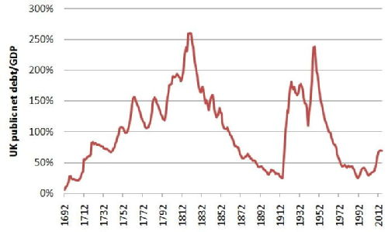
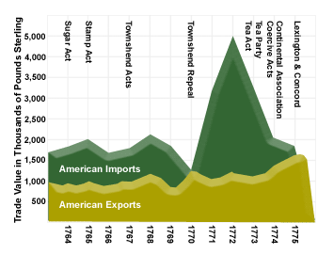
What do these charts show?

Slide 23
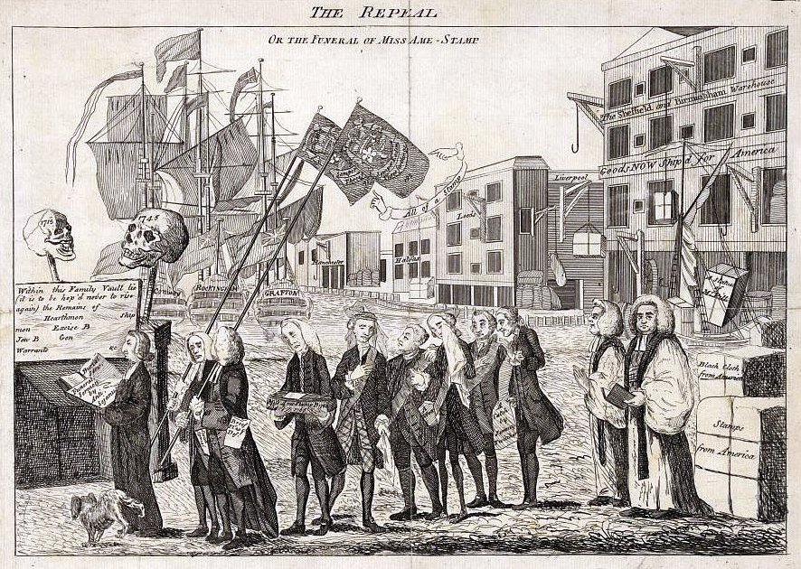
Within this Family Vault, Lie Interred, it is to be hoped never to rise again, The Star Chamber Court Ship Money Excise Money & all Imposts without Parliament. The Act de Haeritico Comburendo Hearth Mon Gener Warrants And which tended to alienate the Affections of Englishmen to their Country.

Slide 24
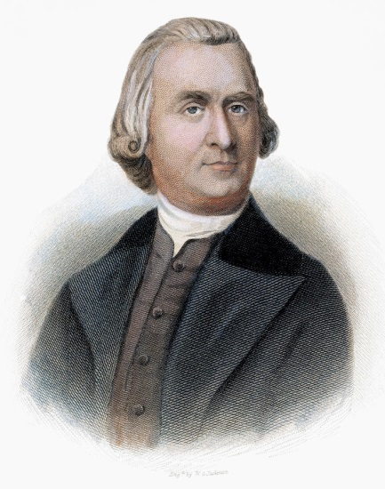
After the Stamp Act’s Repeal and the Declaratory Act…
If taxes are laid upon us without having a legal representation where they are laid, we are reduced from the character of free subjects to the state of tributary slaves.
Similar Problems; Similar Solutions
Townshend Acts (1767)
New duties: glass, paper, tea
Revenue to pay royal officials in colonies
Colonial Resistance
Smuggling, boycotts, protest
Letters from a Farmer in Pennsylvania
Adams’s “Circular Letter”
Mercy Otis Warren
British Response
Call sedition!
Consider abolishing colonial assemblies
Fire Lord Townshend
Samuel Adams

Slide 25
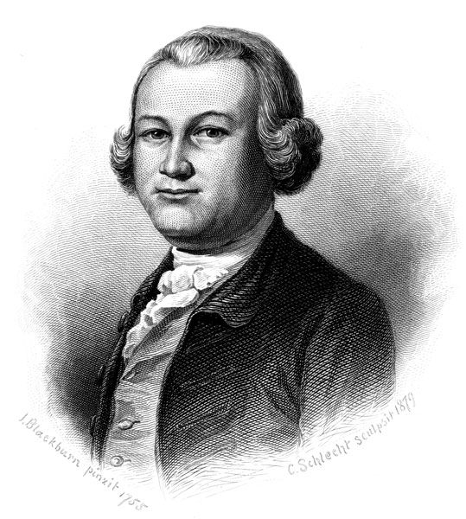
Lord North
Similar Problems; Slightly Different Approach
Repeal all but the Tea Act
Crack down on Smuggling
John Hancock
Writs of Assistance
Means more soldiers
Colonial Reaction
Confrontation
British Response
Boston Massacre (1770)
Every one with this writ may be a tyrant; if this commission be legal, a tyrant in a legal manner, also, may control, imprison, or murder any one within the realm.
James Otis

Slide 26
How Does Boston Interpret This?
Detail from Paul Revere's engraving of "A View of Boston . . . and Brittish Ships of War," depicting the arrival of British soldiers in 1768, published in May 1770. (Gilder Lehrman Collection)

Slide 27
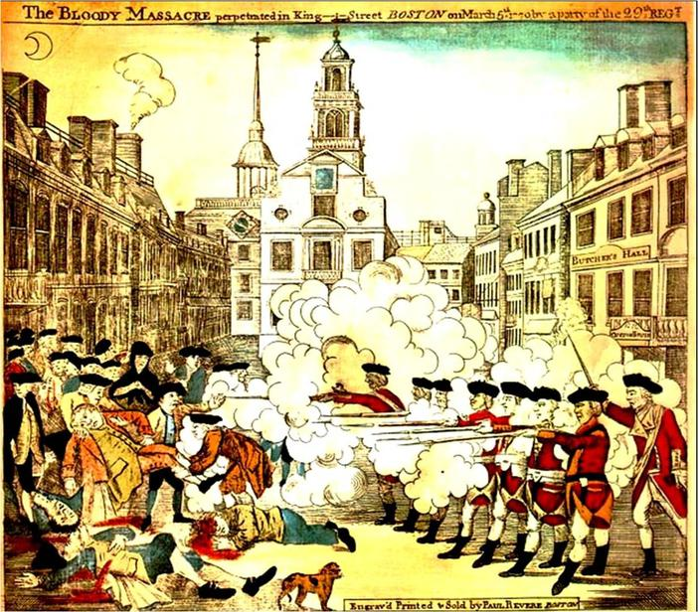
Boston Massacre
Causes
What irritated Bostonians
What soldiers feared
What Sam Adams had to gain
Effects
5 dead, 8 wounded
Trial, most acquitted; 2 thumb branded
Sam Adams gets the “myth”

Slide 28
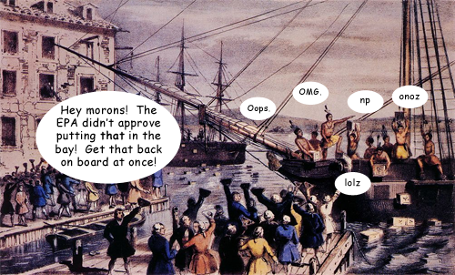
Boston Tea Party
Relative calm 1770-1773
Taxes collected regularly
Tea still boycotted and smuggled
Committees of Correspondence
New Tea Act=cheaper tea, but…
Taxation without representation
Monopoly to the East India Company
So the Sons of Liberty giddyup…

Slide 29
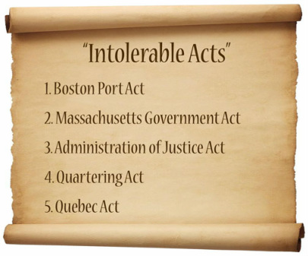
Coercive/Intolerable Acts
Passed May 1774
Among other things…
Port Act—Boston
Massachusetts Assembly
Upper house appointed by king
Town Meetings Abolished
New Quartering Act
Quebec Act
Led to First Continental Congress
Link to scene from HBO’s John Adams https://youtu.be/AA3gvcI58_Q

Slide 30
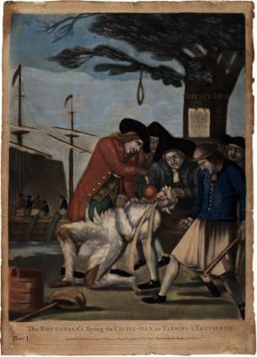
What do you see?
POV Issue…

Slide 31
What’s Up With All the Congresses?
Albany Congress (1754)
Stamp Act Congress (1765)
First Continental Congress (1774)
Second Continental Congress (1775)

Slide 32
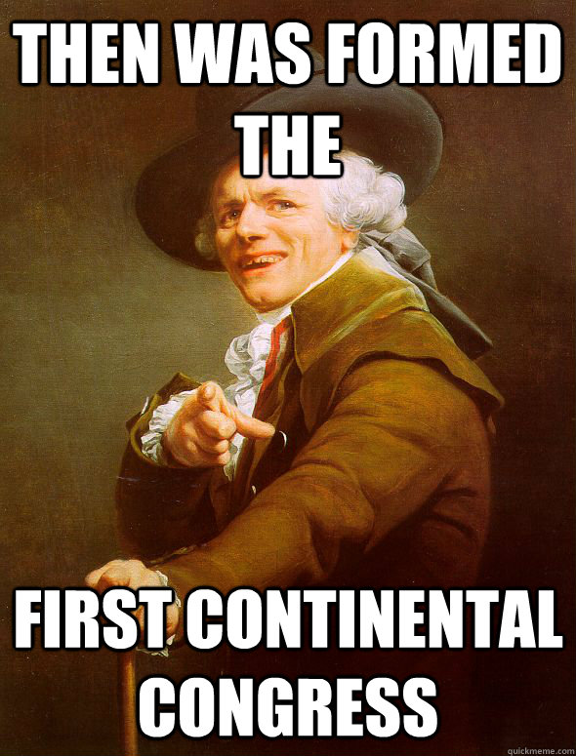
First Continental Congress 3.1.II.B
September 5, 1774
56 delegates from all but Georgia
Big “What do we do now?” Question
Total boycott?
More negotiations?
J. Adams’s Declaration of Rights and Grievances
Suffolk Resolves
Boycott
Free Massachusetts
Establish militias
Petition to George III

Slide 33
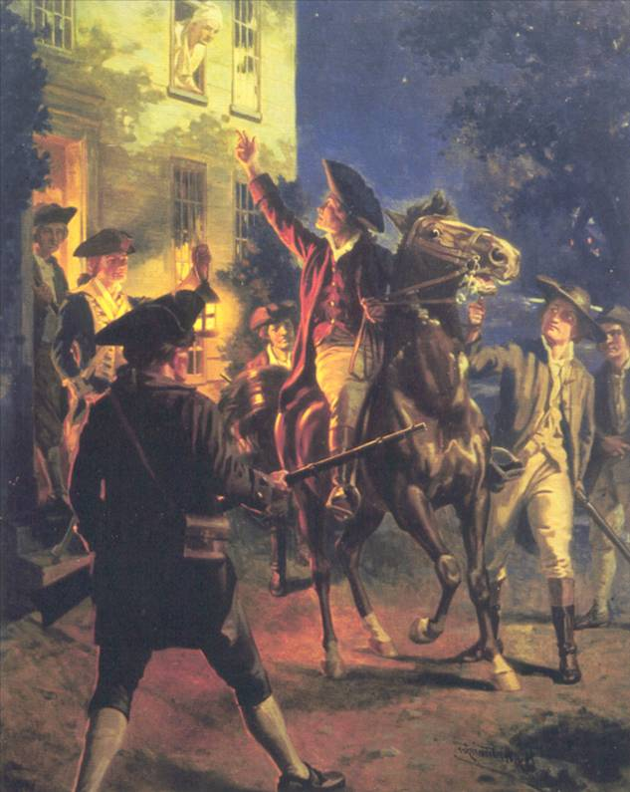
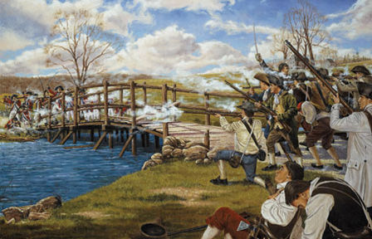
Governor, General Thomas Gage
General Gage
Abolishes all assemblies
Abolishes militias
Attempt to seize store of arms in Concord
Attempt to arrest Hancock and S. Adams
Colonial Response
Paul Revere…
Lexington & Concord
Cannon from Ft. Ticonderoga
Bunker Hill
Second Continental Congress

Slide 34
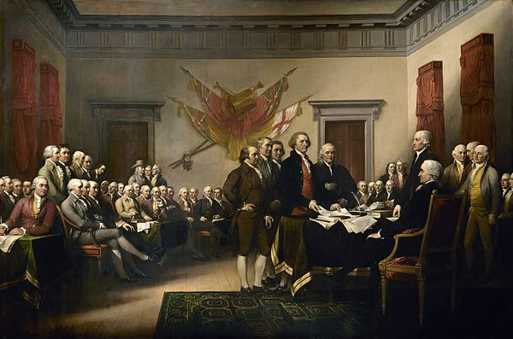
Second Continental Congress 3.1.II.C
Philadelphia, May 1775
Last chance for peace; but prepare for war
Olive Branch Petition
Authorizes printing money
Establish foreign relations
Appoints Washington Commander in Chief
Declares Independence, July 1776
Bunker Hill
Common Sense
George III’s obtuseness
English tradition
Lee’s Resolution
The committee (BF, JA, TJ, RL, RS)

Slide 35
Ideas Have Consequences
Enlightenment Ideas and Thinkers
Republican Government and the Social Contract
John Locke, Second Treatise on Government
Jean-Jacques Rousseau, The Social Contract
Free trade/anti-mercantilism
Adam Smith, The Wealth of Nations
Republicanism and radicalism
Thomas Paine, Common Sense

Slide 36
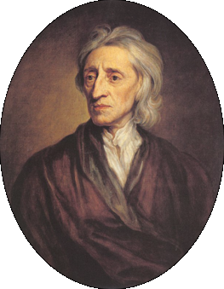
Locke’s Social Contract
“…the rights in the state of nature are constantly exposed to the attacks of others. Since every man is equal and since most men do not concern themselves with equity and justice, the enjoyment of rights in the state of nature is unsafe and insecure. Hence each man joins in society with others to preserve life, liberty, and property.
Since men hope to preserve their property by establishing a government, they will not want that government to destroy this objective. When legislators try to destroy or take away the property of the people, or try to reduce them to slavery, they put themselves into a state of war with the people who can then refuse to obey the laws. . . .It is then the privilege of the people to establish a new legislature to provide for their safety and security. These principles also hold true for the executive who helps to make laws and carry them out.”
--Second Treatise on Government, 1690

Slide 37
So, According to Locke…
Men are born with their rights, but their rights are vulnerable to attack.
Thus men collude socially and agree to a government in order to protect those rights.
But if the government threatens those rights or simply fails to protect them, the people may naturally replace the government with one that will protect their rights.

Slide 38
Does this apply?
Consider alongside Jefferson’s discussion of “light and transient causes.”

Slide 39
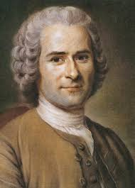
Rousseau’s Social Contract
“The problem is to find a form of association which will defend and protect with the whole common force the person and goods of each associate, and in which each, while uniting himself with all, may still obey himself alone, and remain as free as before. This is the fundamental problem of which the Social Contract provides the solution. . . .
These clauses, properly understood, may be reduced to one — the total alienation of each associate, together with all his rights, to the whole community; for, in the first place, as each gives himself absolutely, the conditions are the same for all; and, this being so, no one has any interest in making them burdensome to others. . . .
Finally, each man, in giving himself to all, gives himself to nobody; and as there is no associate over whom he does not acquire the same right as he yields others over himself, he gains an equivalent for everything he loses, and an increase of force for the preservation of what he has. . . .
Each of us puts his person and all his power in common under the supreme direction of the general will, and, in our corporate capacity, we receive each member as an indivisible part of the whole.”
--From The Social Contract, 1762

Slide 40
So, according to Rousseau…
In a free society, the general will and common good promote the rights of all.
By sacrificing one’s own interest to the general interest, a man secures his own interest.
In a voluntary republican society, there is no self-interest.

Slide 41
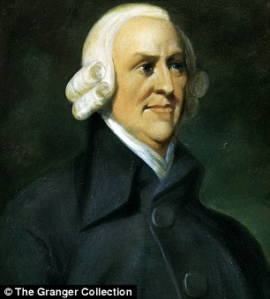
Adam Smith’s Wealth of Nations
“Nobody ever saw a dog make a fair and deliberate exchange of one bone for another with another dog. Nobody ever saw one animal by its gestures and natural cries signify to another, this is mine, that yours; I am willing to give this for that....But man has almost constant occasion for the help of his brethren, and it is in vain for him to expect it from their benevolence only. He will be more likely to prevail if he can interest their self-love in his favour, and show them that it is for their own advantage to do for him what he requires of them. Whoever offers to another a bargain of any kind, proposes to do this. Give me that which I want, and you shall have this which you want, is the meaning of every such offer; and it is in this manner that we obtain from one another the far greater part of those good offices which we stand in need of.”
“It is not from the benevolence of the butcher, the brewer, or the baker that we expect our dinner, but from their regard to their own self-interest.”
“Every man lives by exchanging.”
“Individual Ambition Serves the Common Good.”

Slide 42
More Smith
“The statesman who should attempt to direct private people in what manner they ought to employ their capitals would not only load himself with most unnecessary attention but assume an authority which could safely be trusted to no council and senate whatever, and which would nowhere be so dangerous as in the hands of man who have folly and presumption enough to fancy himself fit to exercise it. ”

Slide 43
So, according to Smith…
Men exchange goods and services in order to accomplish selfish goals.
In a free society, the only way to acquire what you want from others is to give others what they want.
Free exchanges benefit both sides, and greed becomes good.
Governments do not need to intervene and tell men what they want or need, and

Slide 44
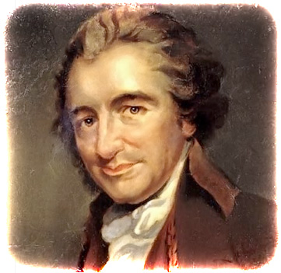
Thomas Paine’s Common Sense
“The sun never shined on a cause of greater worth. ‘Tis not the affair of a city, a country, a province, or a kingdom, but of a continent—of at least one eighth part of the habitable globe. ‘Tis not the concern of a day, a year, or an age; posterity are virtually involved in the contest, and will be more or less affected, even to the end of time, by the proceedings now. . . .”
“But Britain is the parent country, say some. Then the more shame upon her conduct. Even brutes do not devour their young, nor savages make war upon their families . . .”
“I challenge the warmest advocate for reconciliation, to shew, a single advantage that this continent can reap, by being connected with Great Britain. I repeat the challenge, not a single advantage is derived. . . .”
“Every thing that is right or natural pleads for separation. The blood of the slain, the weeping voice of nature cries, ‘TIS TIME TO PART. . . .”
“I am not induced by motives of pride, party, or resentment to espouse the doctrine of separation and independence; I am clearly, positively, and conscientiously persuaded that it is the true interest of this continent to be so . . .”
“O ye that love mankind! Ye that dare oppose, not only the tyranny, but the tyrant, stand forth!”
*Drops mic*

Slide 45
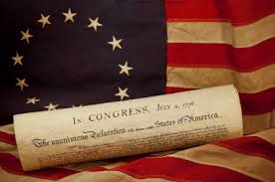
A New War
Not just for a redress of grievances
For INDEPENDENCE!
Then What?
Government?
Society?
Economy?
How do we beat the British?

Slide 46
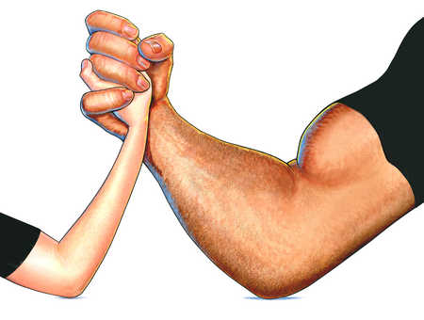
An Unequal Match (3.1.II.D,E)
Americans
British
No established government
No financial system
No credit
No navy
No army, mostly rag-tag militia
Few experienced officers
Knowledge of the area
Internal lines
A Cause
Established government
Strong financial system
Vast line of credit
Most powerful navy in the world
Large, trained & equipped army
Large, experienced officer corps
Unfamiliar and hostile territory
External lines
A job

Slide 47
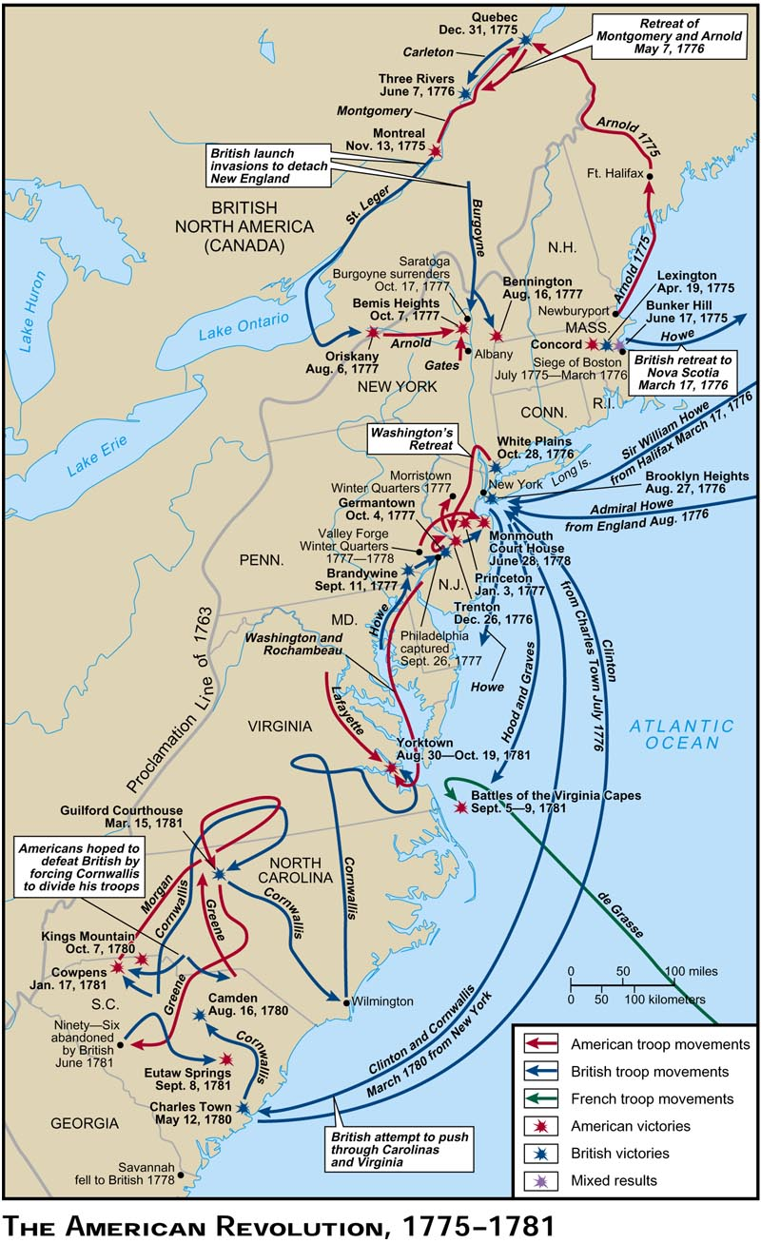
Key Battles: Turning Points 3.1.II.E
Ticonderoga—Liberation of Boston
Trenton; Princeton (sorta)
SARATOGA
Vincennes (sorta)
Cowpens and Guliford Courthouse
Yorktown

Slide 48
Tactics: European-Style

Slide 49
Tactics: Militia Style

Slide 50
YouTube—The Patriot: Militia Ambushes
YouTube—Boston Massacre https://youtu.be/YcDoN-KEiKQ?t=34s
Tarring and feathering--https://youtu.be/KdpKEs_dMHc

Slide 51
Strategies
America
British
Get help from France!
Survive long enough to sue for peace.
Control key areas/cities
Mobilize loyalists
Crush Washington’s army

Slide 52
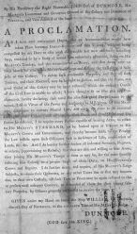
Lord Dunbar’s Proclamation
Use the Patriots’ Slaves
Runaway slaves who fight for the King gain their freedom.
3,000-4,000 signed his ledger
Est. total 10,000 escaped or died in war

Slide 53
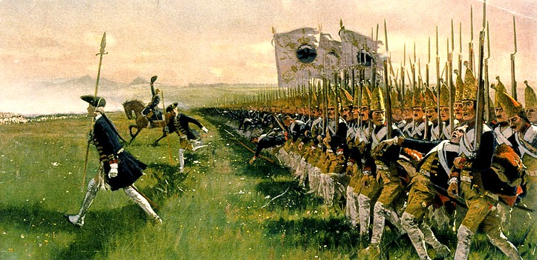
Hessians
German mercenaries
Battle of Long Island
Battle of Trenton

Slide 54
Treaty of Paris, 1783 3.1.II.E
John Jay, Benjamin Franklin, and John Adams
Separate negotiations with British, French, and Spanish
Terms:
Britain retains Canada
Prewar debts to British Merchants
Protection of loyalists
Independence to 13 colonies
U.S. controls west to Mississippi River
Fishing rights off Nova Scotia

