Slide 1
APUSHING 2.1
Europeans developed a variety of colonization and migration patterns, influenced by different imperial goals, cultures, and the varied North American environments where they settled, and they competed with each other and American Indians for resources

Slide 2
What exactly is this key concept about?
How and why European governments established colonies
Why different groups of Europeans migrated to the colonies
How the various environments in America affected colonial developments
How and why Europeans, colonists, and American Indians competed over resources

Slide 3
2.1.1
Spanish, French, Dutch, and British colonizers had different economic and imperial goals involving land and labor that shaped the social and political development of their colonies as well as their relationships with native populations

Slide 4
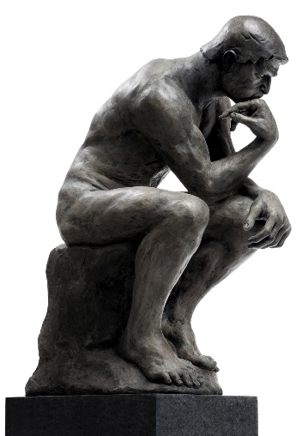
Spanish Economic & Political Goals
Mercantilism and markets
Wealth extraction (economic)
Subjugation of American Indians (economic and political)
Control of natural resources (economic and political)
Converting Indians to Catholic Christianity (political)
How is this political?
Protestant Reformation?

Slide 5
Spanish Means to their Ends
The Conquistador model…
Gold and silver via conquest and mining
Encomienda and African slavery
Missions
Sociedad de las castas

Slide 6
Spanish Colonialism in a Nutshell

Slide 7
French & Dutch Economic & Political Goals
Mercantilism and markets
Wealth via exchange
Trade alliances and intermarriage
Jesuit missionaries (for France)

Slide 8
French & Dutch Means to their Ends
The trade and diplomacy model…
Smaller scale than Spanish
Less military-based; more trade and diplomacy
Emphasis on furs and unfinished resources for export to Europe

Slide 9
French & Dutch Colonialism in a Nutshell
Really?
No.
Then why?

Slide 10
English Economic & Political Goals
Mercantilism and markets
Creation of wealth (export of natural resources; agriculture)
Social mobility
Religious freedom

Slide 11
English Means to their Ends
Mass-migrations
Salutary neglect
Limited trade with American Indians
Selective conquest of Indians’ land

Slide 12
English Colonialism in a Nutshell

Slide 13
2.1.2
In the 17th century, early British colonies developed along the Atlantic coast, with regional differences that reflected various environmental, economic, cultural, and demographic factors.

Slide 14
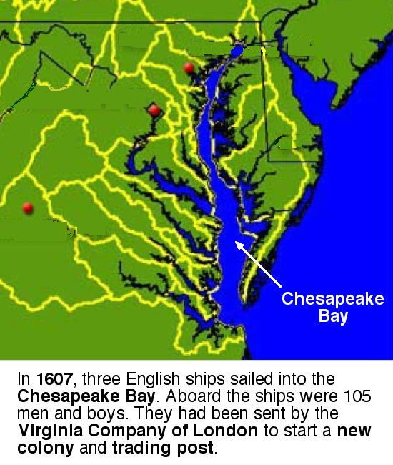
Chesapeake and North Carolina
Tobacco farming and exports
Labor intensive, scarce labor
Indentured servitude then African slavery

Slide 15
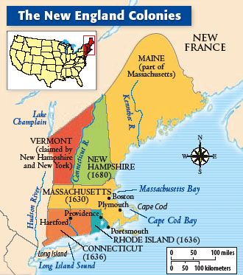
New England Colonies
Puritans
Church, family, local community
Mixed economy of agriculture and commerce

Slide 16
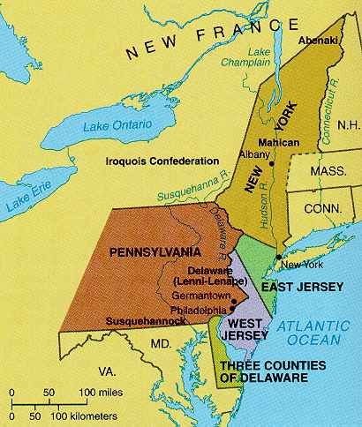
Middle Colonies
Ethnic, cultural, and religious diversity
Cereal crops (“The Breadbasket Colonies”)
Relative tolerance

Slide 17
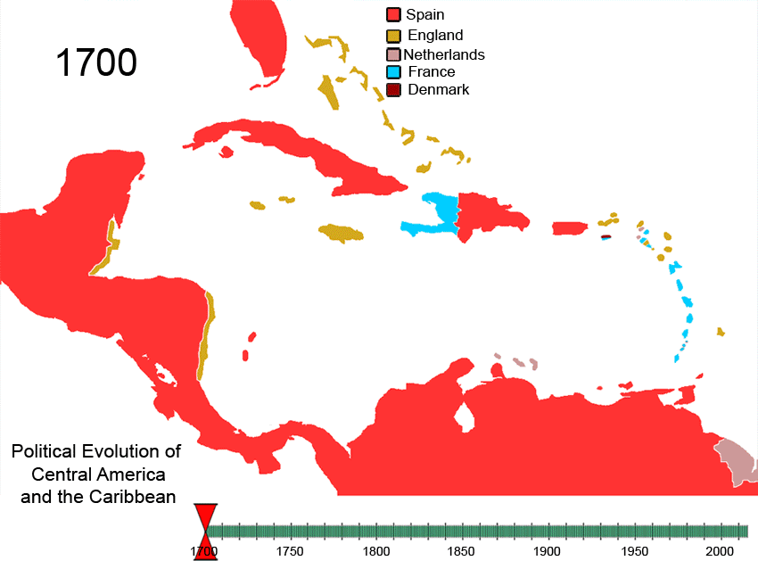
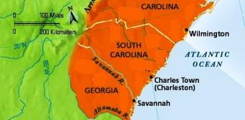
Southern Atlantic Coast and British West Indies
Plantation economies
African slavery

Slide 18
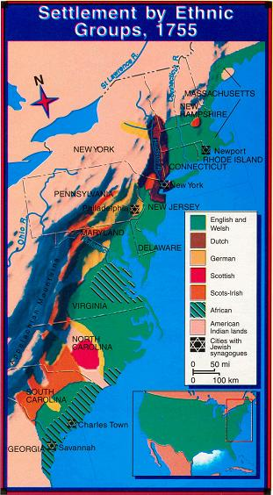
Colonial Diversity
Which region is the most diverse and why?
Which is second and why?
Which is the least and why?
Which region would you most prefer to live in and why?
Which region is more like the United States today and why?

Slide 19
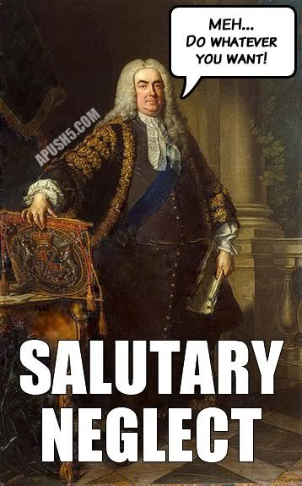
Salutary Neglect
Relatively self-governing colonies
Unusually democratic colonies
Town meetings in New England
Planter elites in the South

Slide 20
2.1.3
Competition over resources between European Rivals and American Indians encouraged Industry and trade and led to conflict in the Americas.

Slide 21
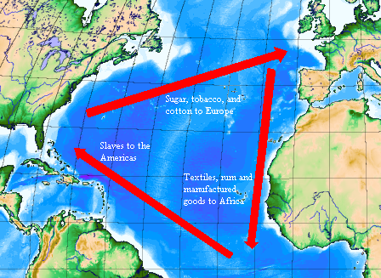
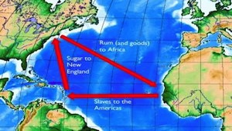
The Atlantic Economy
Colonialism and mercantilism in action
Triangular Trade Routes
Exchanges in goods and peoples

Slide 22
Of course it’s actually more complicated…

Slide 23
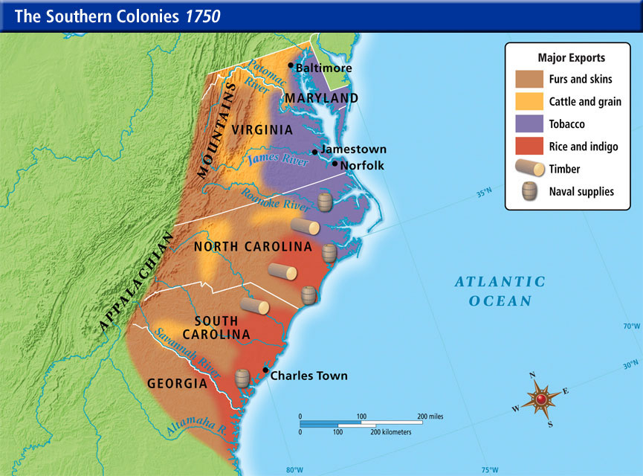
How does this fit into British mercantilism?

Slide 24
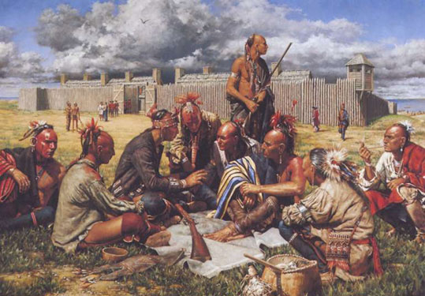
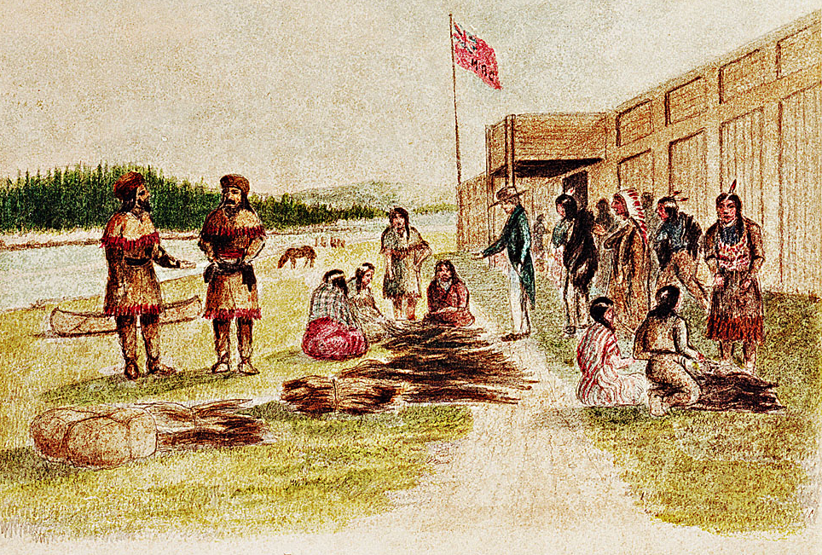
Trade Between American Indians and Europeans
Cultural effects
Economic changes
Demographic shifts

Slide 25
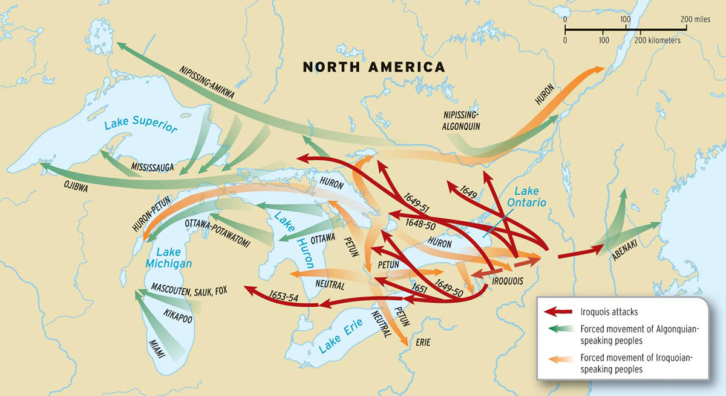
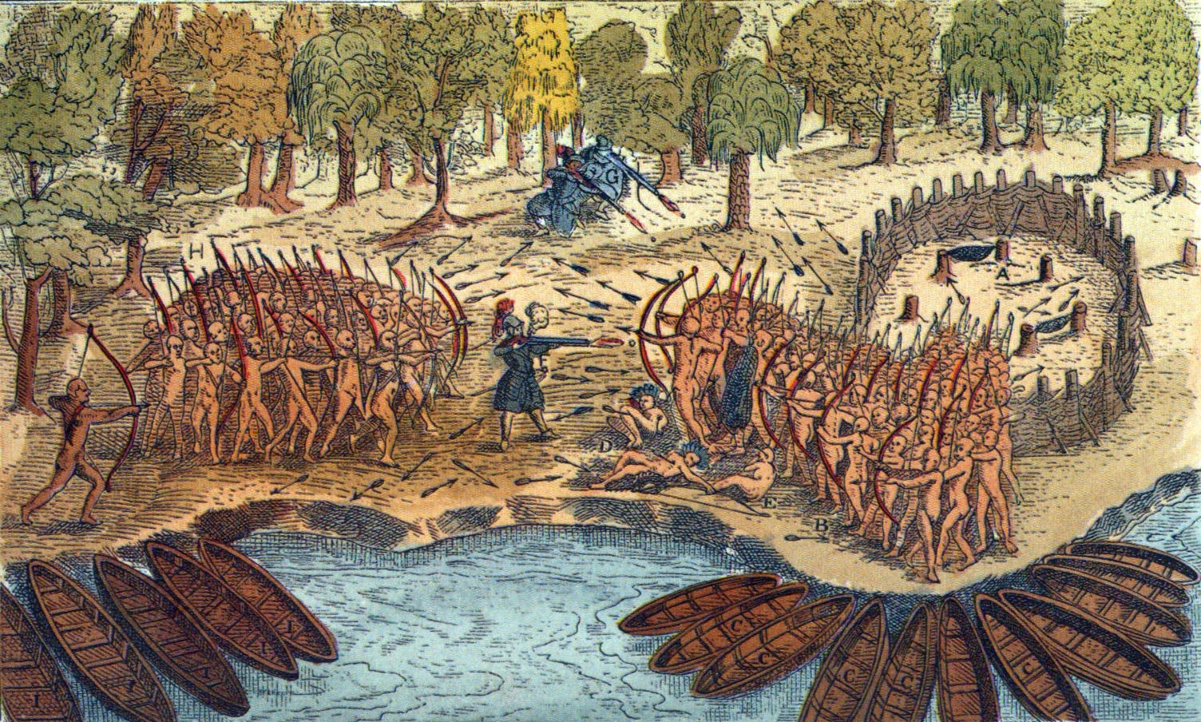
Interactions, Accommodations, and Conflict
French ally with Algonquian
British ally with Iroquois
Beaver Wars (Dutch & British v. French by proxy)

Slide 26
Developing Problems in the Colonies
Growing mistrust and resentment (Creoles in New Spain)
Diverging interests between Britain and its colonies
Territorial settlements
Frontier defense
Self-rule
Trade

Slide 27
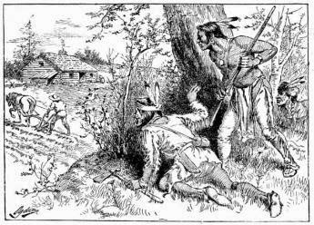
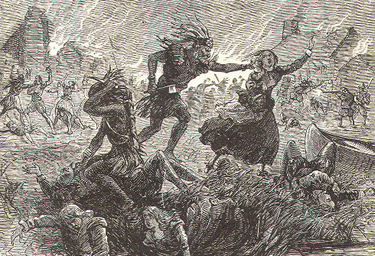
British Conflicts w/American Indians
Issues of land, resources, and political boundaries
Military conflict
Raid on Jamestown
Pequot War
King Philip’s War

Slide 28
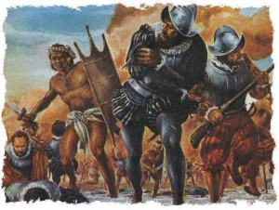
American Indians Resist Spain
Spain “asks” for too much
Pueblo Revolt
Spanish accommodation of “some aspects” of Indian culture

